Slide 1
ATLAS Results on Production of Quarkonia and Heavy Flavor
Sally Seidel, for the ATLAS Collaboration
DIS2020
24 March 2020

Slide 2
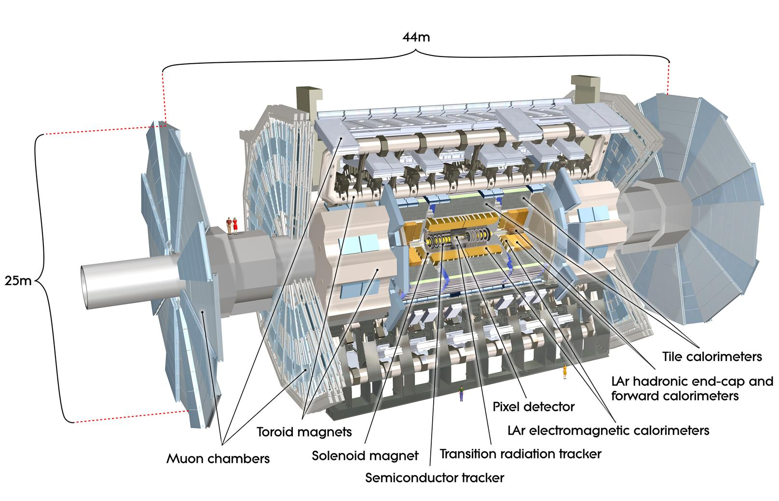
Four recent results in quarkonium and heavy flavors from ATLAS, using LHC pp data.
ATLAS from inside to out:
Inner detector (pixel, silicon microstrips, straw-tube TRT) |η| < 2.5, surrounded by a 2T axial B field from the solenoid
Sampling calorimeters (LAr EM |η| < 3.2; Scint tile HAD |η| < 3.2; LAr HAD 1.5 < |η| < 4.9)
Air core toroids provide B field for Muon drift tubes + cathode strip chambers (muon tracking to |η| < 2.7) and resistive plate + thin gap chambers (triggering to |η| < 2.4)

Slide 3
J/ψ Production in Association with a W± Boson at 8 TeV
Relative B_{c}±/B± Production Cross Section at 8 TeV
Production Cross Section of J/ψ and ψ(2S) at high p_{T} at 13 TeV
J/ψp Resonances in the Decays at 7 and 8 TeV

Slide 4
Measurement of J/ψ Production in Association with a W± Boson at 8 TeV*
Message: Associated prompt production of J/ψ + W± probes the mechanism for charmonium production in hadronic collisions. and is proposed to be a clear means to compare the color octet and color singlet models.
The outcome: measurements of 3 ratios, all with the form:
R_{fid} - “fiducial” – independent of unknown J/ψ spin alignment or J/ψ acceptance corrections
R_{incl} - “inclusive” – accounting for J/ψ spin alignment and J/ψ acceptance corrections
R_{DPS-sub} - “inclusive with double parton scattering subtracted” – remove cases where the J/ψ and W± come from different parton pairs.
Results are compared to NLO color octet prediction for single-parton scattering.**
*JHEP 01 (2020) 095
**M. Song et al., Chin. Phys. Lett. 30 (2013) 091201, extended to 8 TeV by original authors.

Slide 5
Motivation:
The main models for perturbative calculations of quarkonium production in hadronic collisions differ in how the system is produced:
in a color singlet (CS) state (requires 2 hard gluons in color singlet initial state, or one gluon splitting into QQ then one Q radiating a hard gluon)
-or-
with QQ remaining in color octet (CO) state and then generating color-neutral meson by low energy non-perturbative matrix elements.
Associated J/ψ + W± production has been presented* as a clear signature of CO processes, although higher-order CS processes have also been proposed.**
* G. Li et al., Phys. Rev. D 83 (2011) 014001.
** B.A. Kniehl et al., Phys. Rev. D 66 (2002) 114002.

Slide 6
Overview of the method:
20.3 fb⁻¹ of pp collisions at 8 TeV – this is a factor 4 increase in dataset size over previous ATLAS measurement*
Find the W’s: W is associated with the primary vertex (PV) through transverse impact parameter. Tracks must pass isolation criteria. Improve W selection through cut on transverse mass.
Find the J/ψ’s: If a W event has 2 additional muons, apply a J/ψ reconstruction with common-vertex constraint. Select on: 8.5 < p_{TJ/ψ} < 150 GeV and |y_{J/ψ}| < 2.1.
Limit to prompt J/ψ’s – produced in the initial hard interaction either directly or indirectly through feed-down (including radiatively) from a heavier charmonium state. Prompt candidates have a pseudo-proper decay time τ consistent with zero, where
Suppress systematic uncertainties on W reconstruction and integrated lumi by taking the ratio of prompt cross sections to inclusive W cross section.
* ATLAS collaboration, HEP 04 (2014) 172.

Slide 7
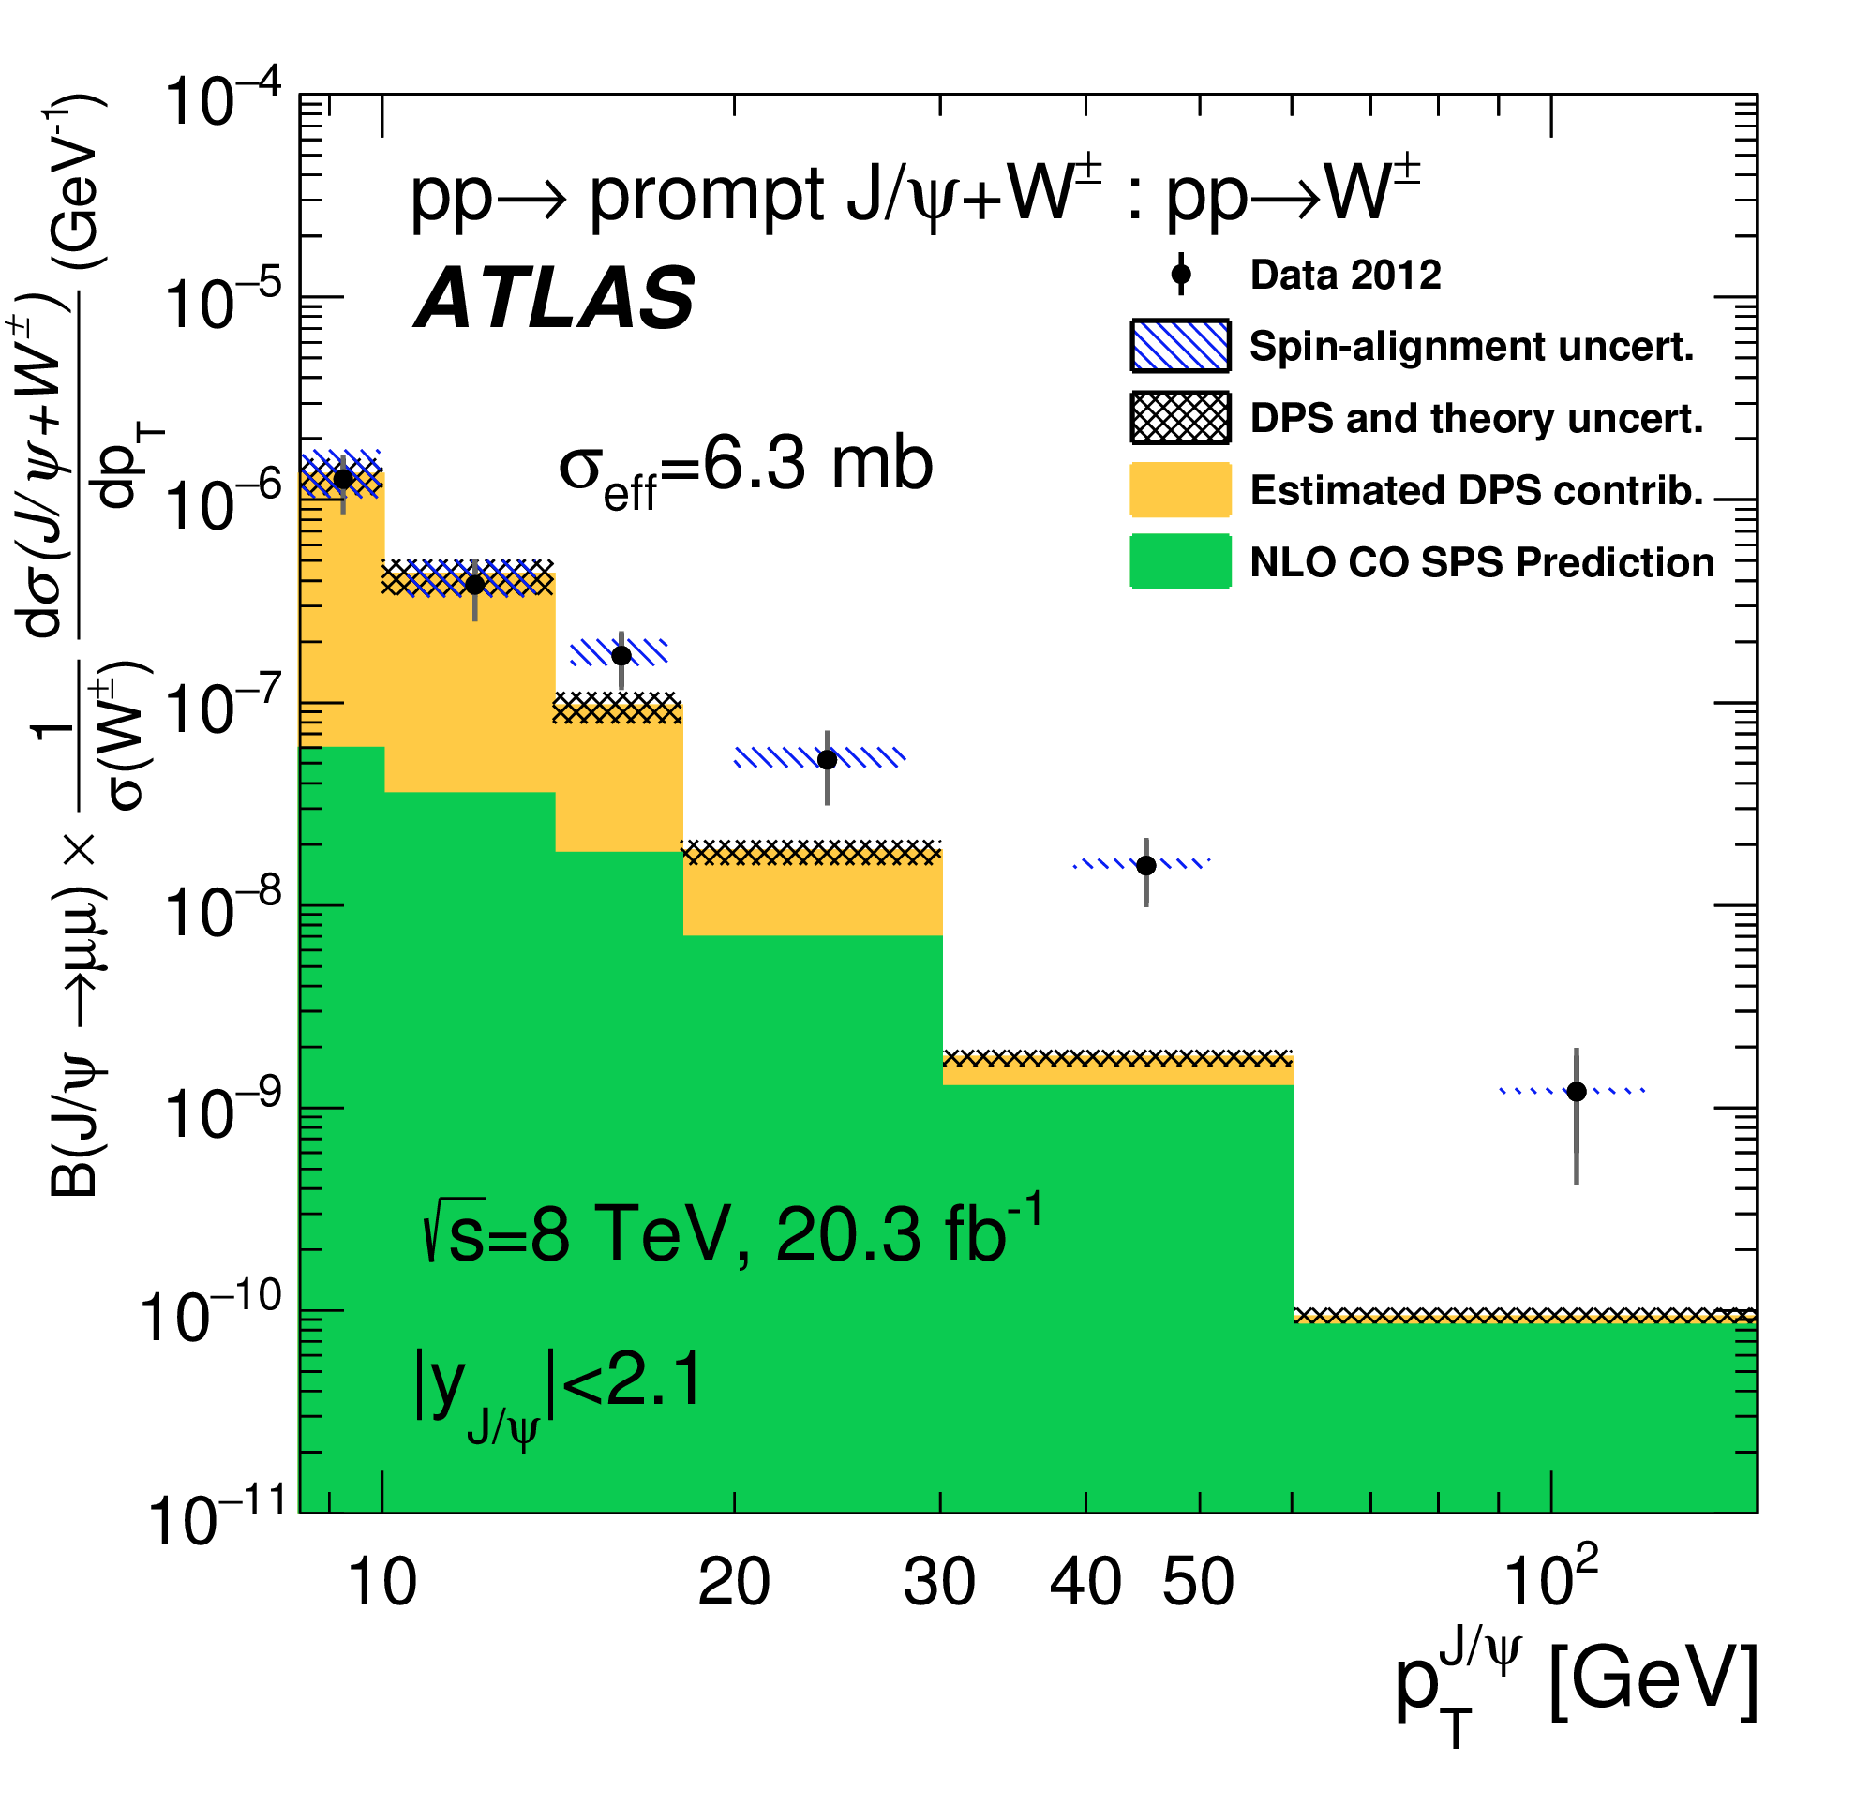
Results binned for |y_{J/ψ}| < 1 and 1 < |y_{J/ψ}| < 2 and, for the full |y| bin, differentially in p_{TJ/ψ}.
Measurements of the azimuthal angle between the W± and the J/ψ indicate that double parton scattering (DPS), in which the J/ψ and the W come from different hard interactions, is present.
The DPS contribution P^{ij} is estimated for a process containing a W±, using the measured cross-section σ^{ij}_{J/ψ} for J/ψ production and the effective transverse overlap area of the interacting partons σ_{eff}: Results are presented for σ_{eff} =15 mb and 6.3 mb.
Result:
The predicted cross section ratio is closer to data for σ_{eff} = 6.3 mb, but neither value of σ_{eff} allows a good match to the J/ψ p_{T} dependence. Inclusion of color singlet processes may improve the agreement.

Slide 8
Measurement of the Relative B_{c}±/B± Production Cross Section at 8 TeV*
Message and motivation: No published calculation of the cross section at 8 TeV is available. Evidence of dependence on this cross section on p_{T}(B) is shown. This is the first measurement of this relative cross section for this combination of fiducial volume and energy.
The outcome: is measured for bins:
2 p_{T} bins for the rapidity range |y(b)| < 2.3:
13 GeV < p_{T}(B_{c}±) < 22 GeV and p_{T} > 22 GeV
2 rapidity bins for the p_{T} range p_{T}(B) > 13 GeV:
|y| < 0.75 and 0.75 < |y| < 2.3
and for the full range: p_{T} > 13 GeV and |y| < 2.3
* arXiv:1912.02672 [hep-ex]

Slide 9
The method:
Find the J/ψ: combine every oppositely-signed pair of muons, constrain to a common vertex.
Find the B candidates: fit the tracks of the 2 muons to a charged-hadron track, constrain to a common vertex. Charged hadron takes kaon (pion) mass for B± (B_{c}). Constrain the J/ψ mass to its world average value.
Remove combinatorial background given when J/ψ is combined with unrelated light hadron: select on significance of impact parameter of hadron track relative to PV in transverse plane.
Remove partially-reconstructed B_{c} semileptonic decays in which a muon fakes a hadron.
Find
where ε’s are efficiencies and N^{reco} is extracted from mass distributions by unbinned maximum-likelihood fits.

Slide 10
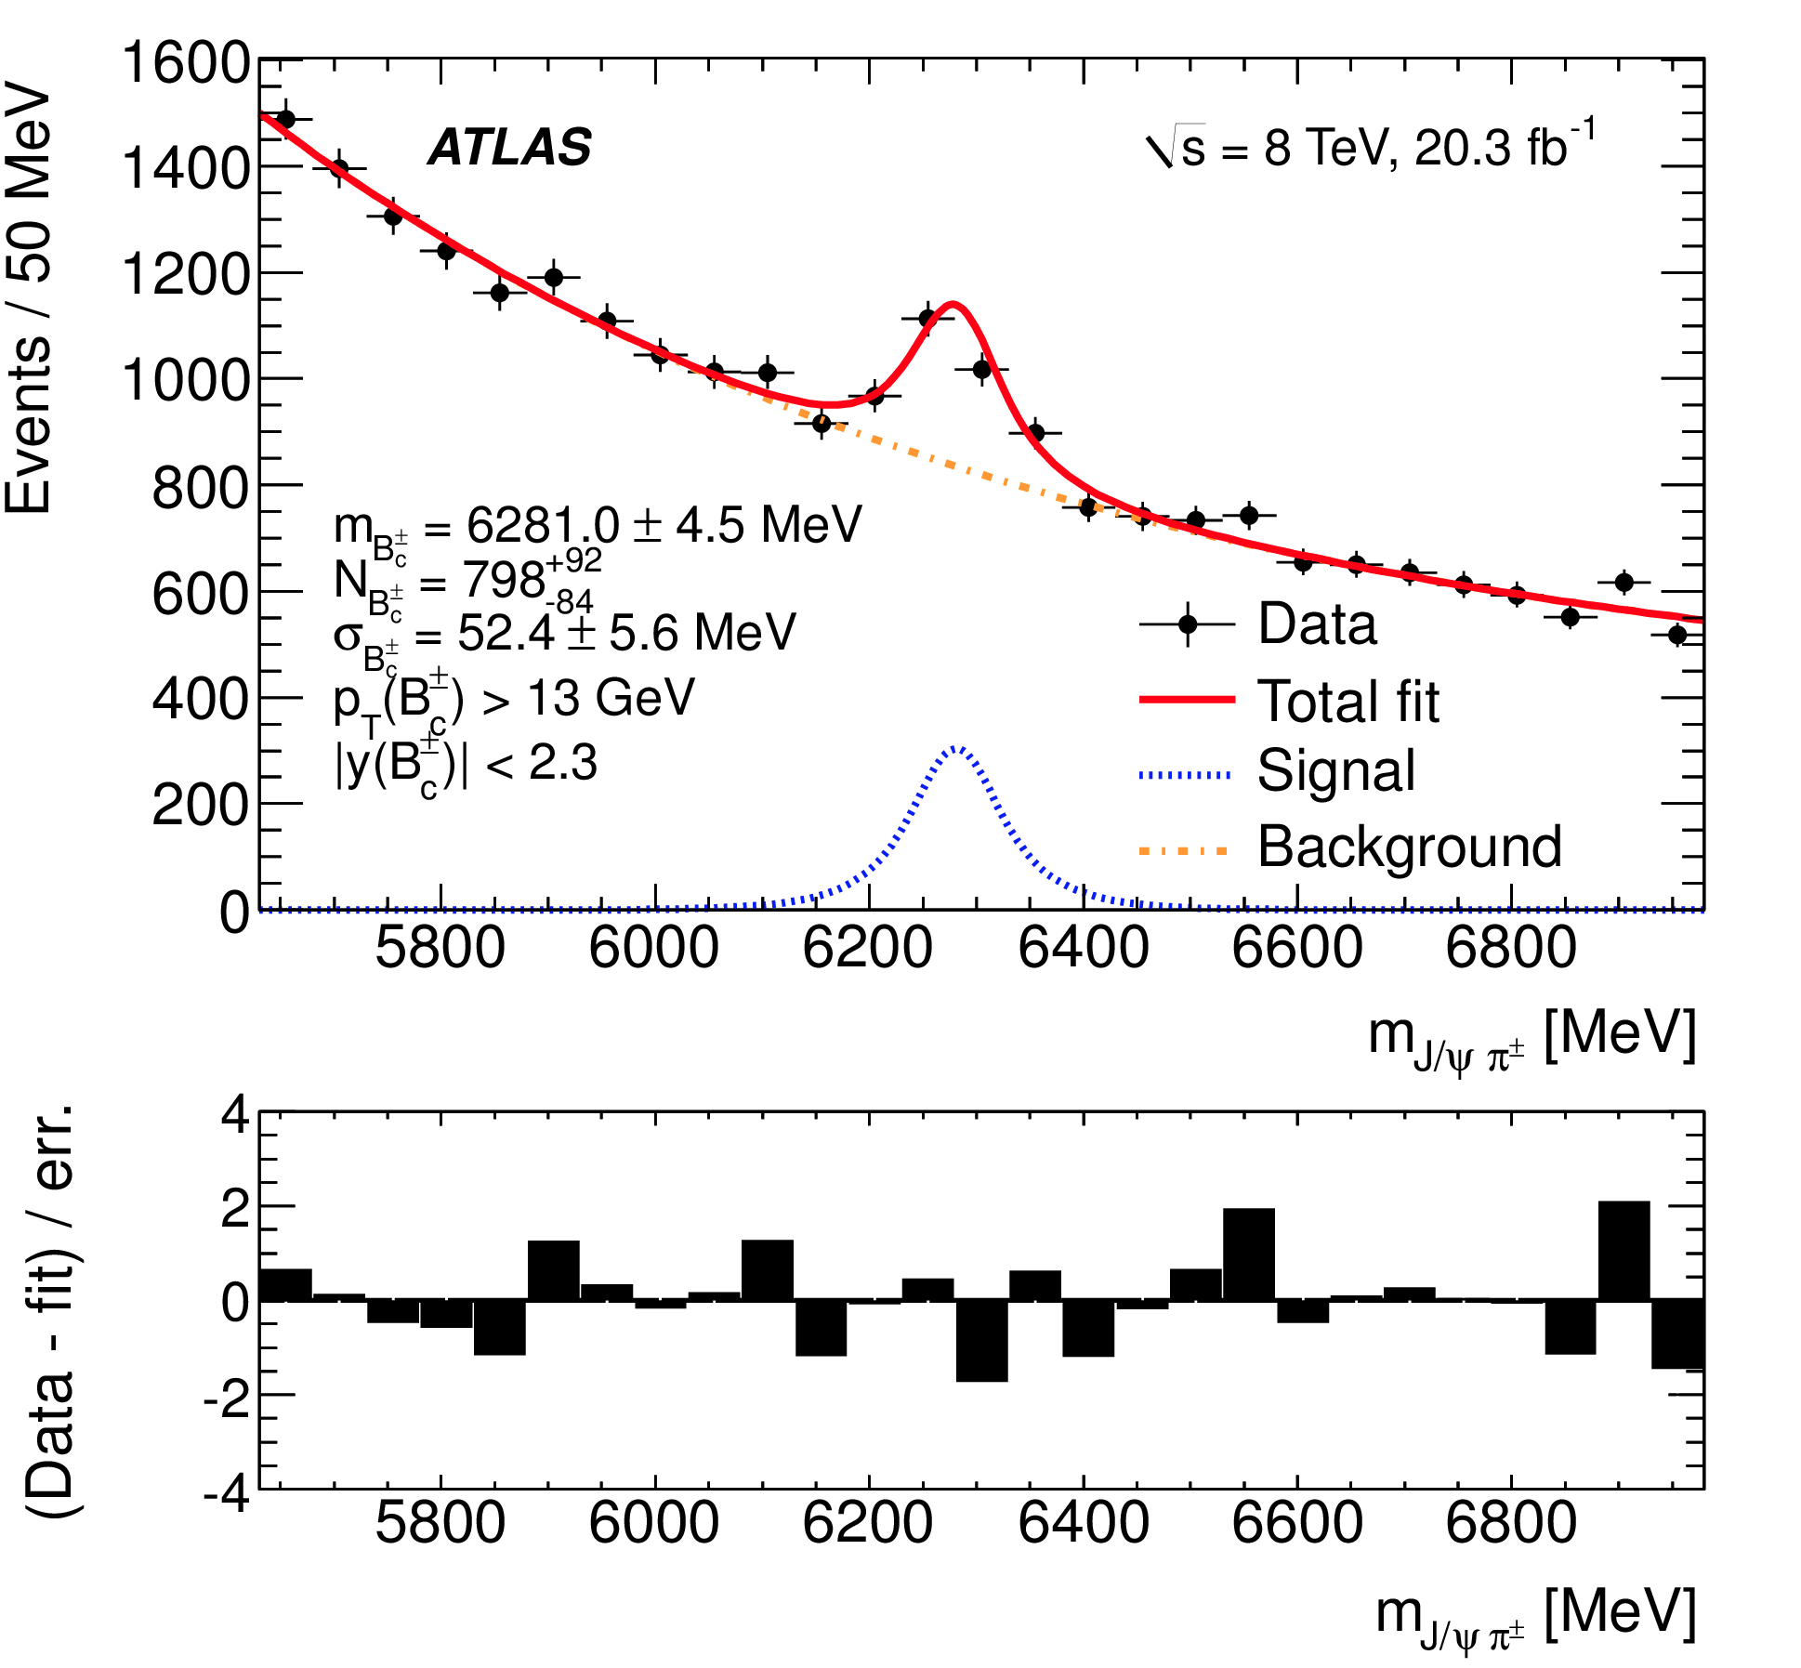
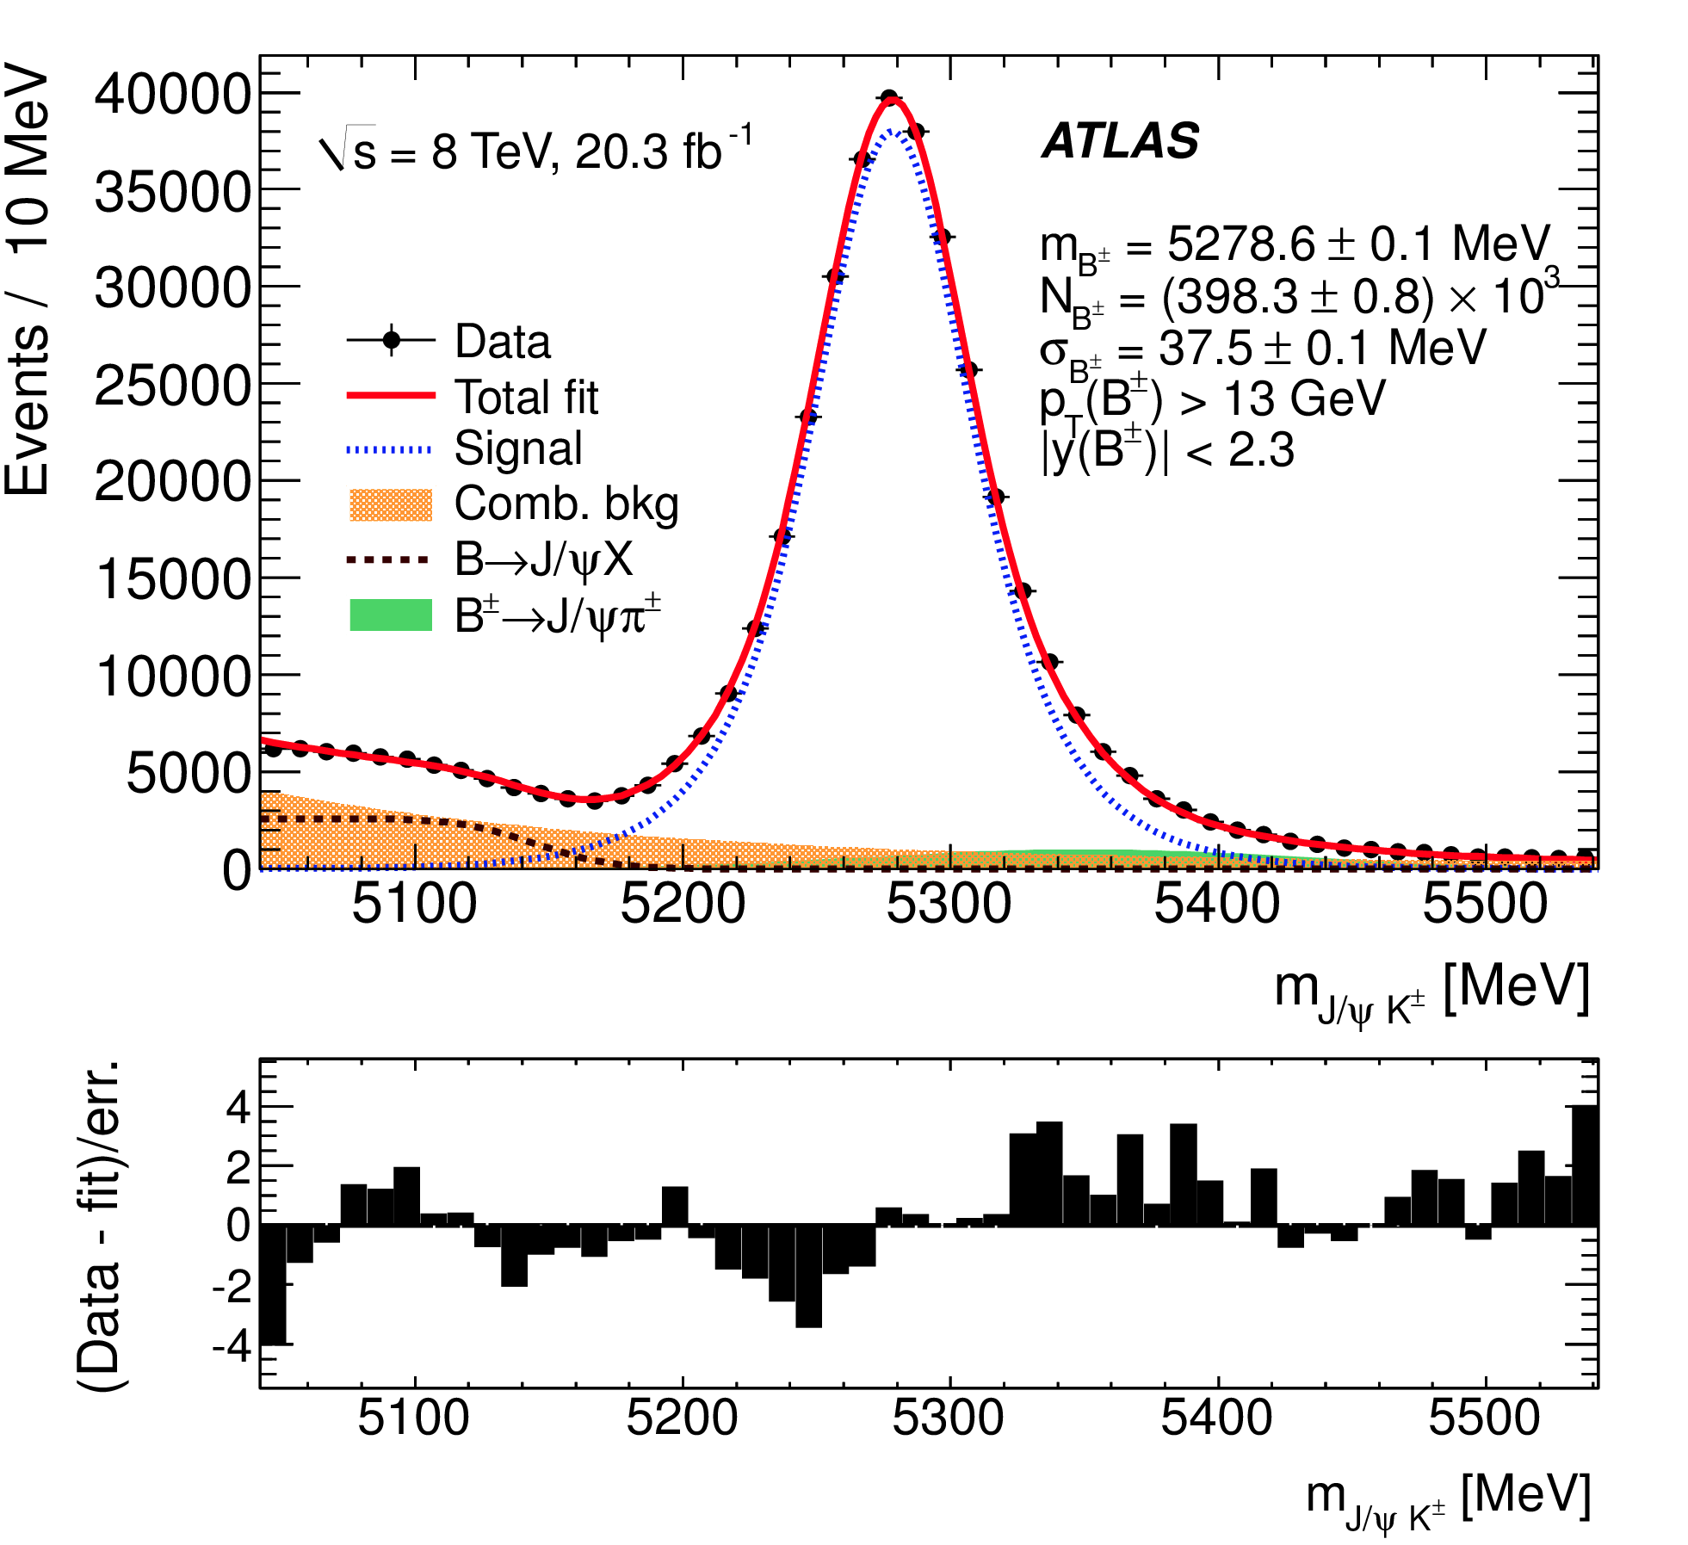
Example invariant mass distributions:
B±
B_{c}
Inclusive result: For full range p_{T} > 13 GeV and |y| < 2.3, the production cross section ratio is 0.34 ± 0.04_{(st)} ± 0.02_{(sy)} ± 0.01_{(lifetime)}.

Slide 11
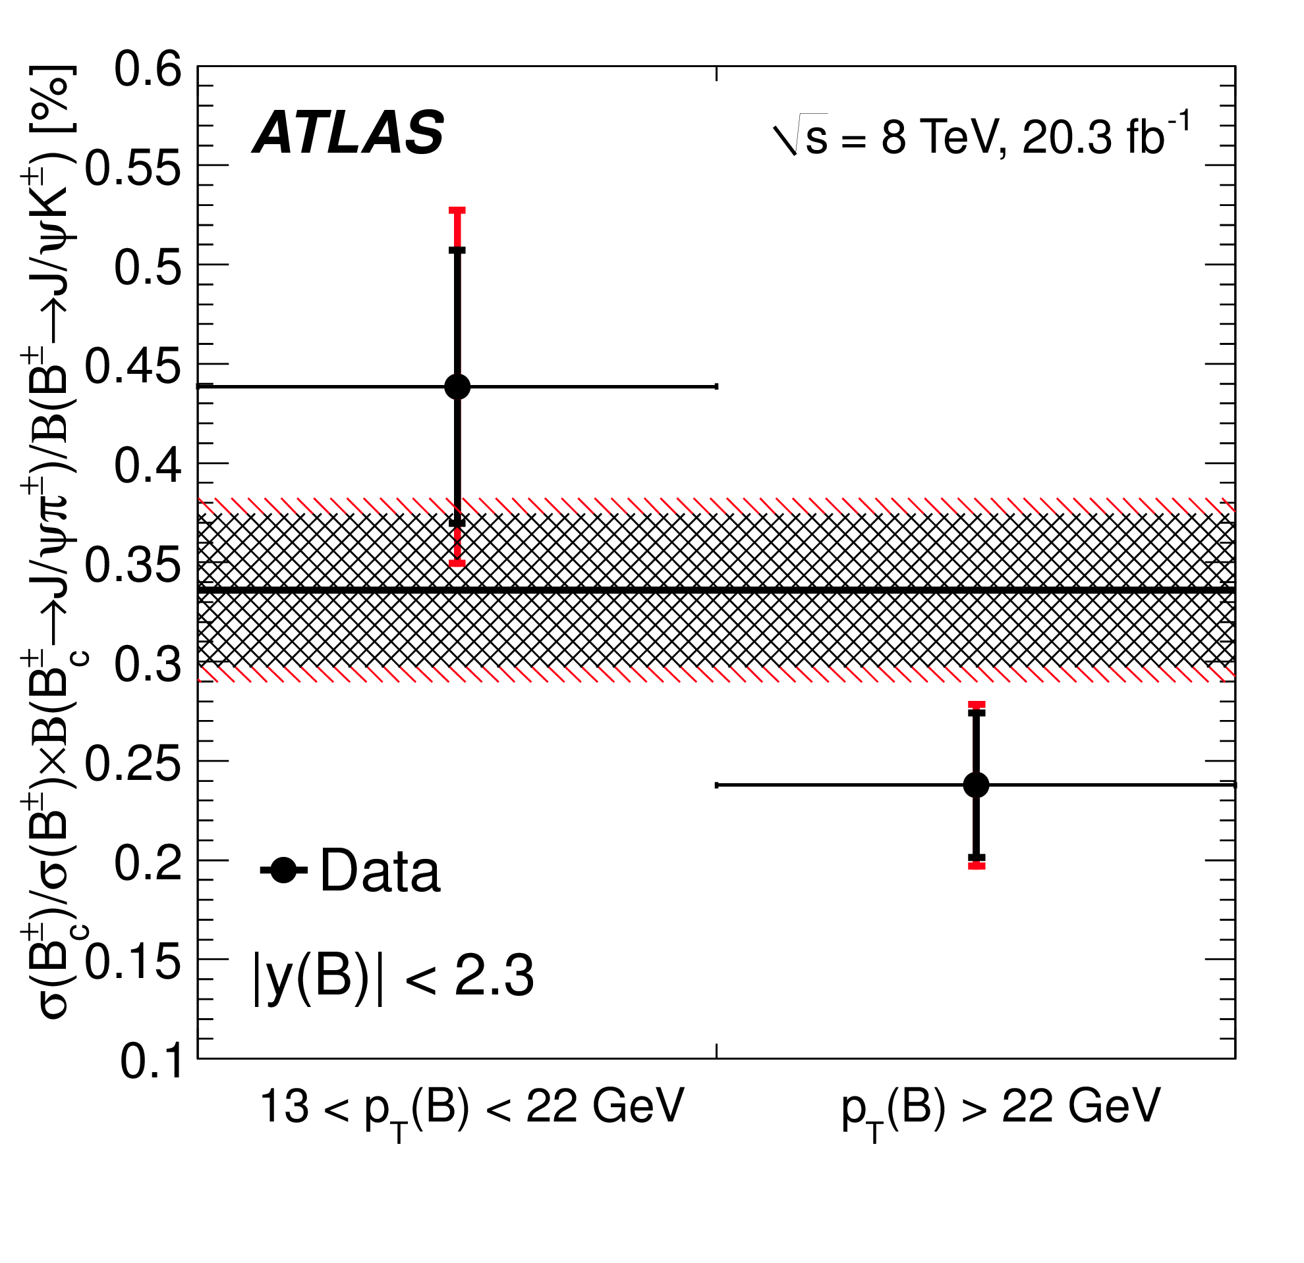
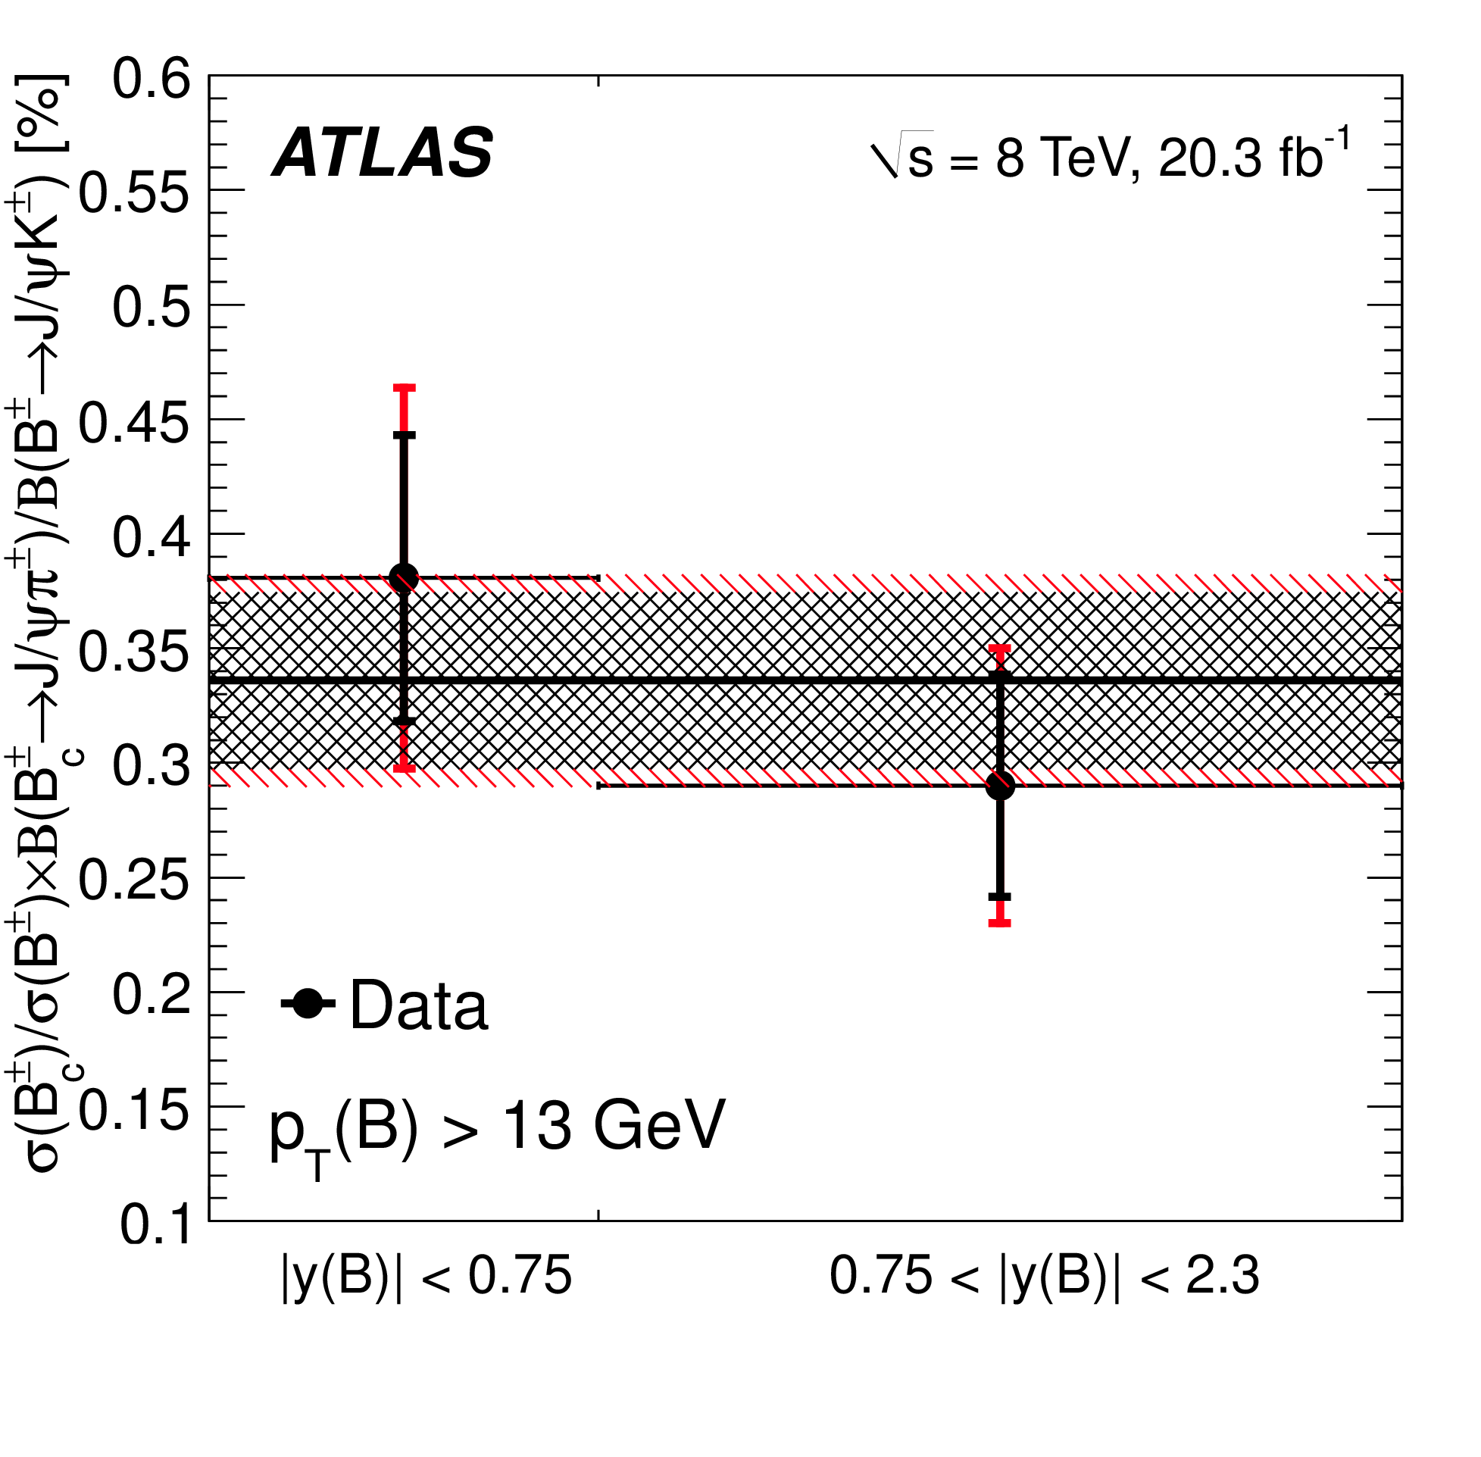
Differential (points) and inclusive (lines) results:
The differential measurement suggests a possible dependence on p_{T}: the production cross section of the B_{c} decreases faster with p_{T} than the production cross section of the B±.
No significant dependence on rapidity is observed.

Slide 12
Measurement of the Production Cross Section of J/ψ and ψ(2S) Mesons at High Transverse Momentum at 13 TeV*
Message – This analysis broadens the scope of comparison between experiment and theory by adding a high p_{T} selection on the quarkonium – this is expected to improve discrimination among competing models** of vector charmonium production.
The outcome - ATLAS has measured:
double differential production cross sections of J/ψ and ψ(2S) through their decays to μ⁺μ⁻
Prompt and non-prompt cross sections separately for both states.
For each state, the ratio of non-prompt to total (i.e. fraction of non-prompt).
For both prompt and non-prompt, the production ratios of ψ(2S) relative to J/ψ.
The characteristics of the measured cross sections are compared to predictions based on the FONLL model.***
*ATLAS-CONF-2019-047
**G. Li et al., PRD 83 (2011) 014001; J.P. Lansberg and C. Lorce, Phys. Lett. B 726 (2013) 218; B. Gong et al., JHEP 03 (2013) 115; M. Song et al., JHEP 02 (2011) 071; M. Butenschoen and B.A. Kniehl, Nucl. Phys. Proc. Suppl. 222-224 (2012) 151.
***M. Cacciari et al., JHEP 0103 (2001) 006; M. Cacciari et al., JHEP 1210 (2012) 137.

Slide 13
The method –
Apply single-muon trigger with threshold p_{T} > 50 GeV
Find the J/ψ’s and ψ(2S) through their decays to μ⁺μ^{-.} At least one muon must have p_{T} > 52.5 GeV.
Compute dilepton mass m(μμ) and pseudo-proper decay time τ [recall from Slide 6] for each event.
Sort data into (12 intervals in p_{T}^{muon}) × (3 intervals in |y|^{muon}). Correct each bin for efficiencies, apply 2-dimensional [in m(μμ), τ] unbinned max likelihood fit to each bin.
Extract yields N^{prompt} and N^{non-prompt} from fits.
Compute double-differential cross section (A is acceptance, C is correction):

Slide 14
Method, continued –
Compute non-prompt fractions:
Compute production ratios of ψ(2S) relative to J/ψ:

Slide 15
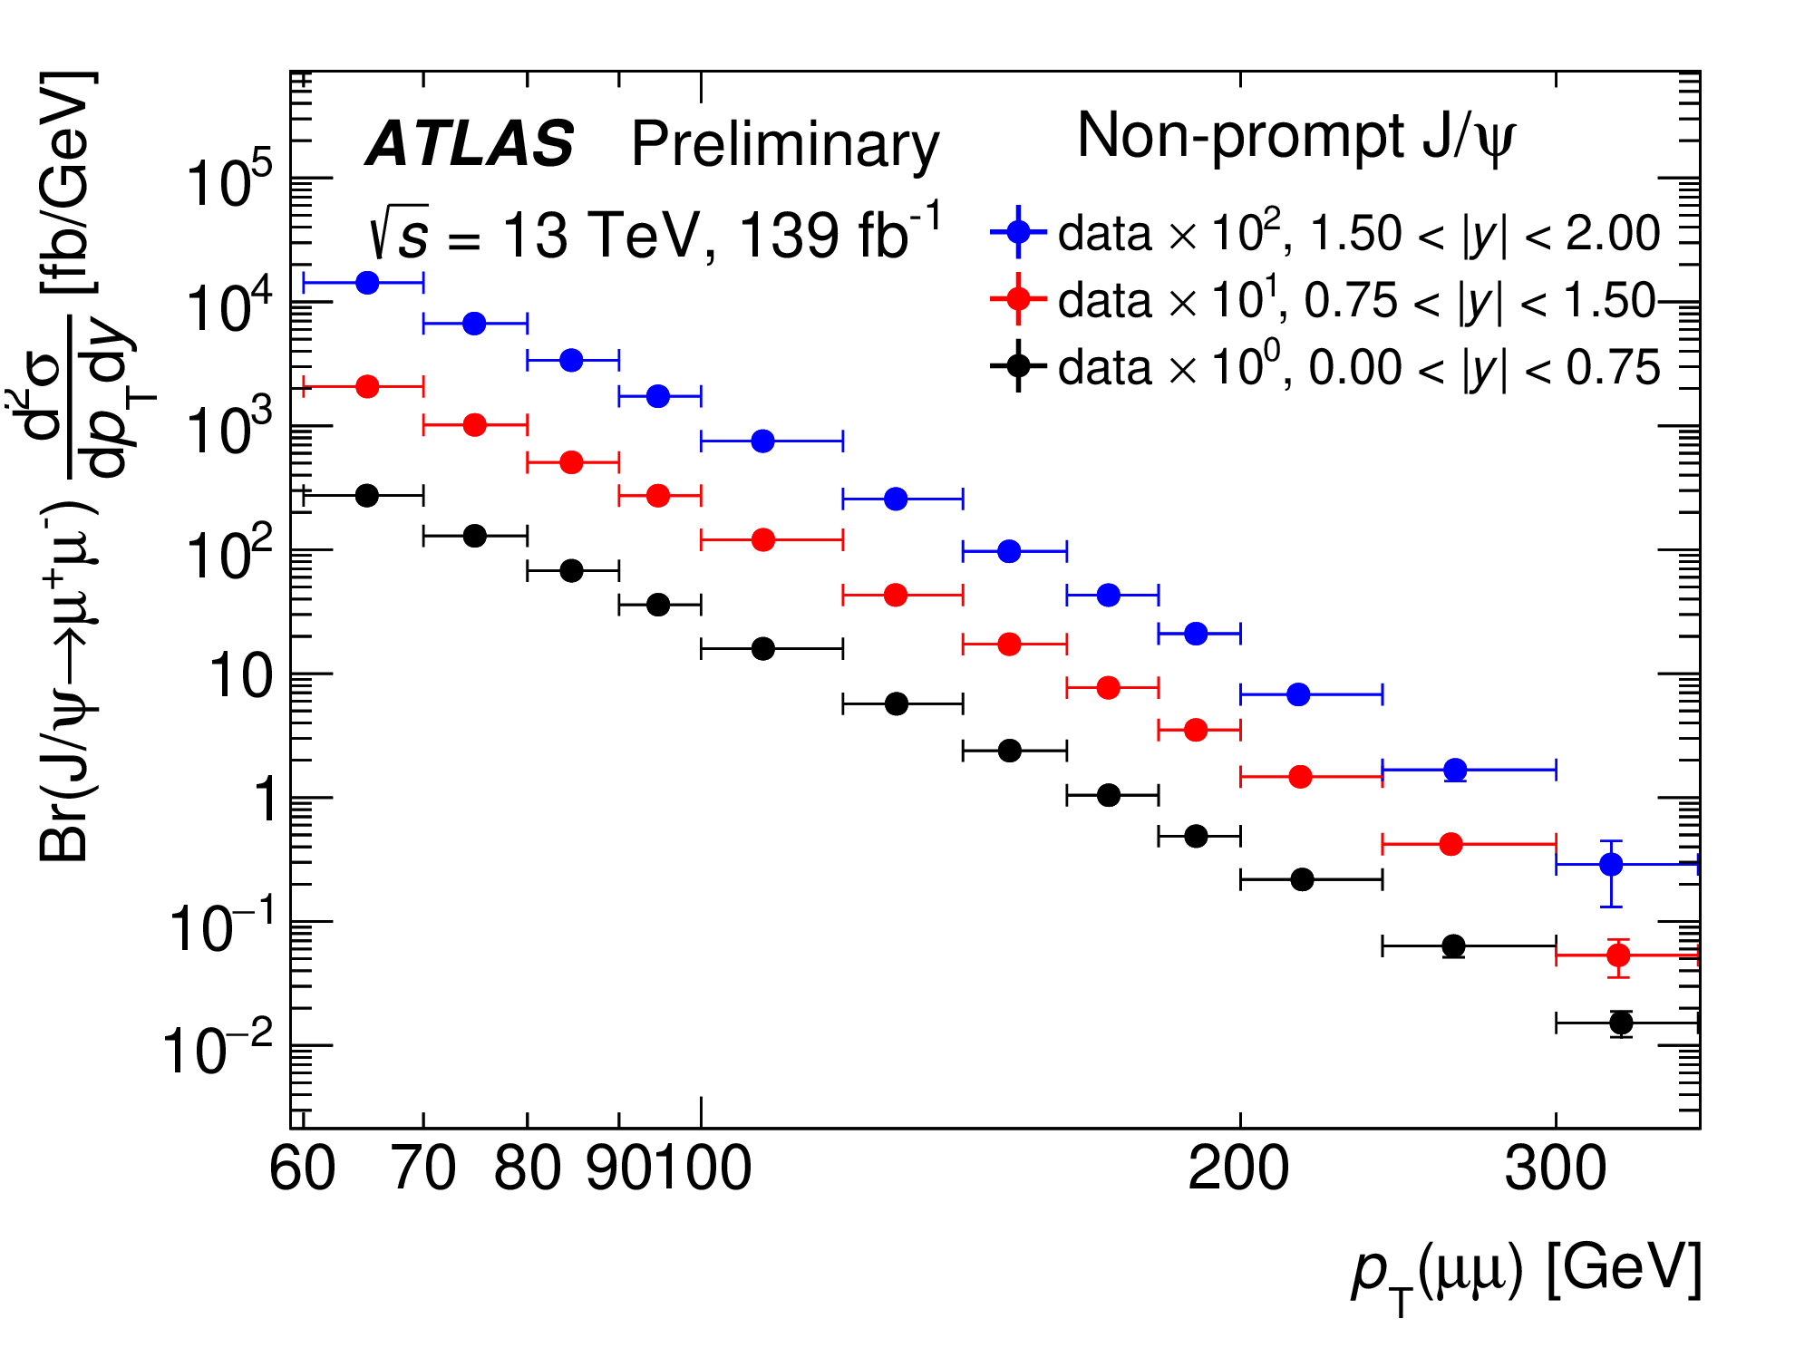
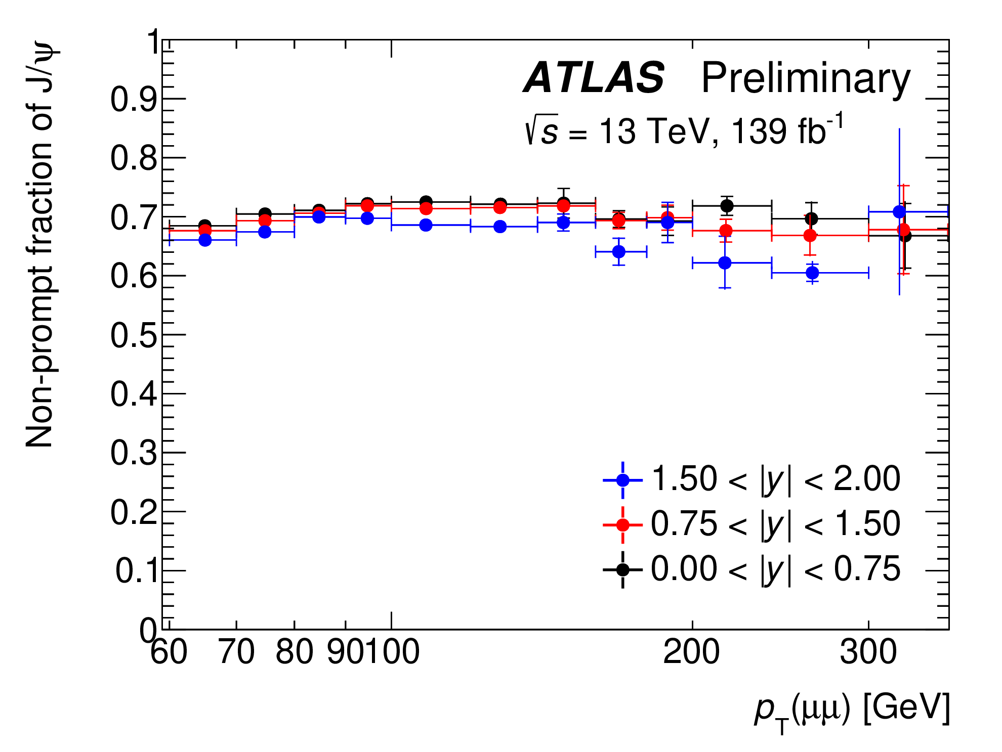
Example results:
Similar p_{T} dependence for prompt and non-prompt cross sections
Non-prompt fraction close to constant in this p_{T} range

Slide 16
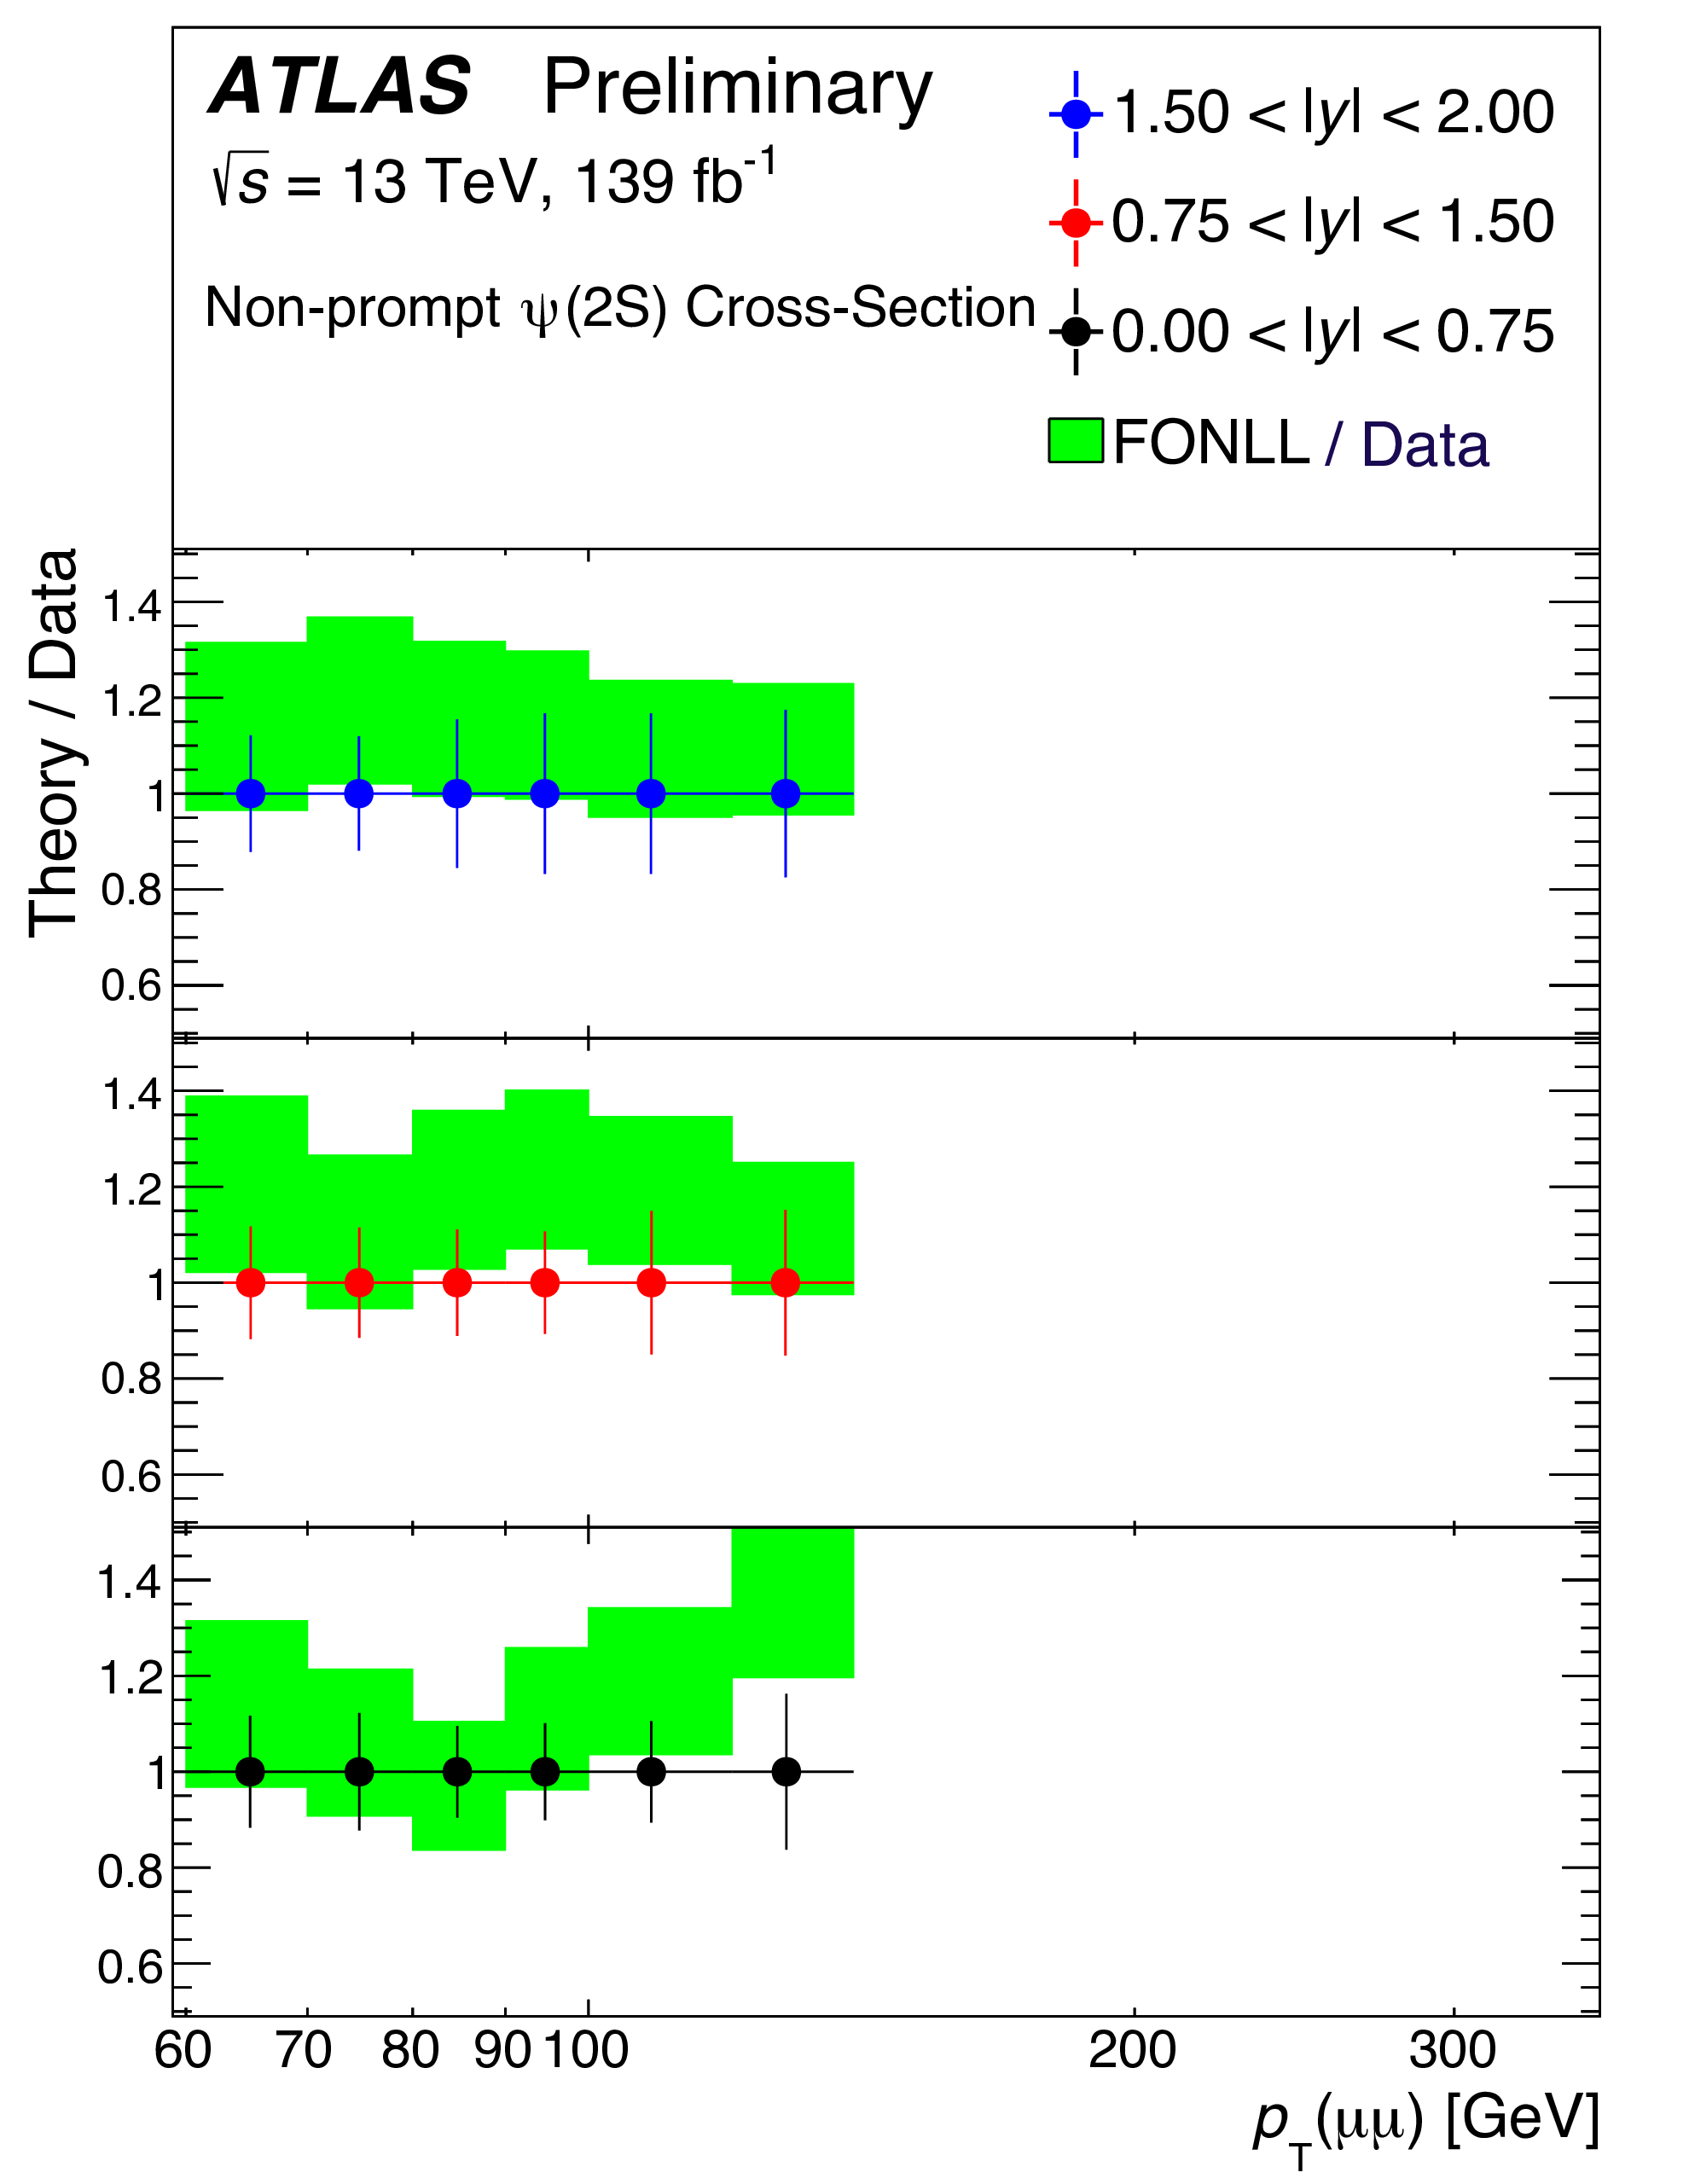
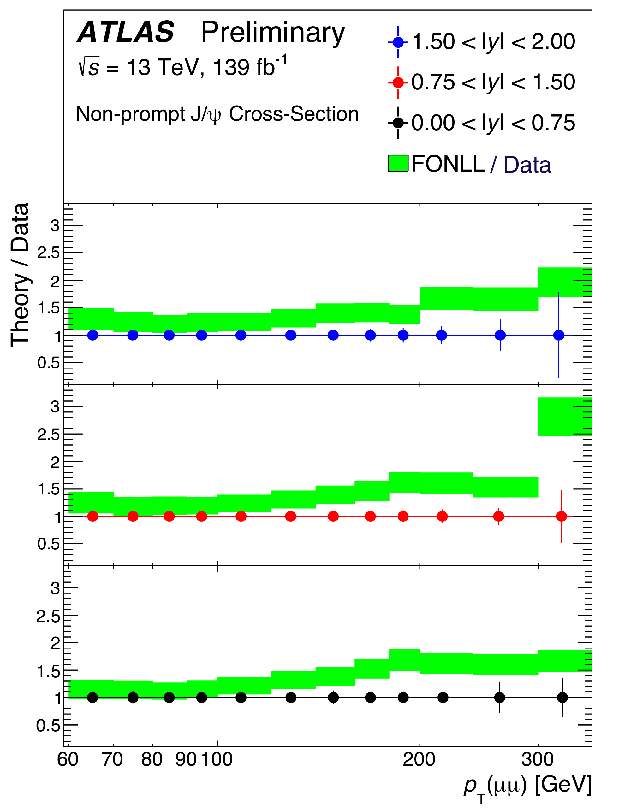
Example results, continued:
Predictions at FONLL for non-prompt production are consistent with measurement at the low end of p_{T} but exceed the data at high p_{T}.

Slide 17
Study of J/ψp Resonances in the Decays at 7 and 8 TeV*
Message: J/ψp resonant structures have been reported** by LHCb where they were initially interpreted as ccuud pentaquark states P_{c}(4380)⁺ and P_{c}(4450)⁺. Subsequently LHCb reported*** that P_{c}(4450)⁺ may represent 2 narrower states, P_{c}(4440)⁺ and P_{c}(4457)⁺, and that a fourth state, P_{c}(4312)⁺ may be present as well. A confirmation of the LHCb observations is sought.
The motivation: Baryons composed of 4 quarks + 1 antiquark have been suggested since the lte 1970’s as a natural prediction of QCD, but observations of pentaquark signals have been controversial.
Outcome: ATLAS data prefer the model with 2 or more pentaquarks. The masses and widths are consistent with the LHCb model of two or more pentaquarks. The model without pentaquarks is however not excluded.
*ATLAS-CONF-2019-048
**LHCb collaboration, PRL 115 (2015) 072001,
***LHCb collaboration, PRL 117 (2016) 082002.

Slide 18
The method:
We are selecting events in ATLAS data, in an effort to confirm LHCb reports of resonant structures in the J/ψp system. Because ATLAS lacks particle ID, we also include these analogous decays of b-quark bound states to J/ψ plus an oppositely charged hadron track pair:
Begin by reconstructing J/ψ candidates from μ⁺μ⁻ pairs and constrain the successful reconstructions to the J/ψ world average mass.
For events containing a J/ψ candidate, seek 2 additional charged hadron tracks. Assign all combinations of identities (p, K, π), including wrong-charge combinations.
Combine the J/ψ candidate + the two charged tracks
Suppress combinatorial background from decays to J/ψ plus light neutral mesons by setting a lower bound on mass m(Kπ).

Slide 19
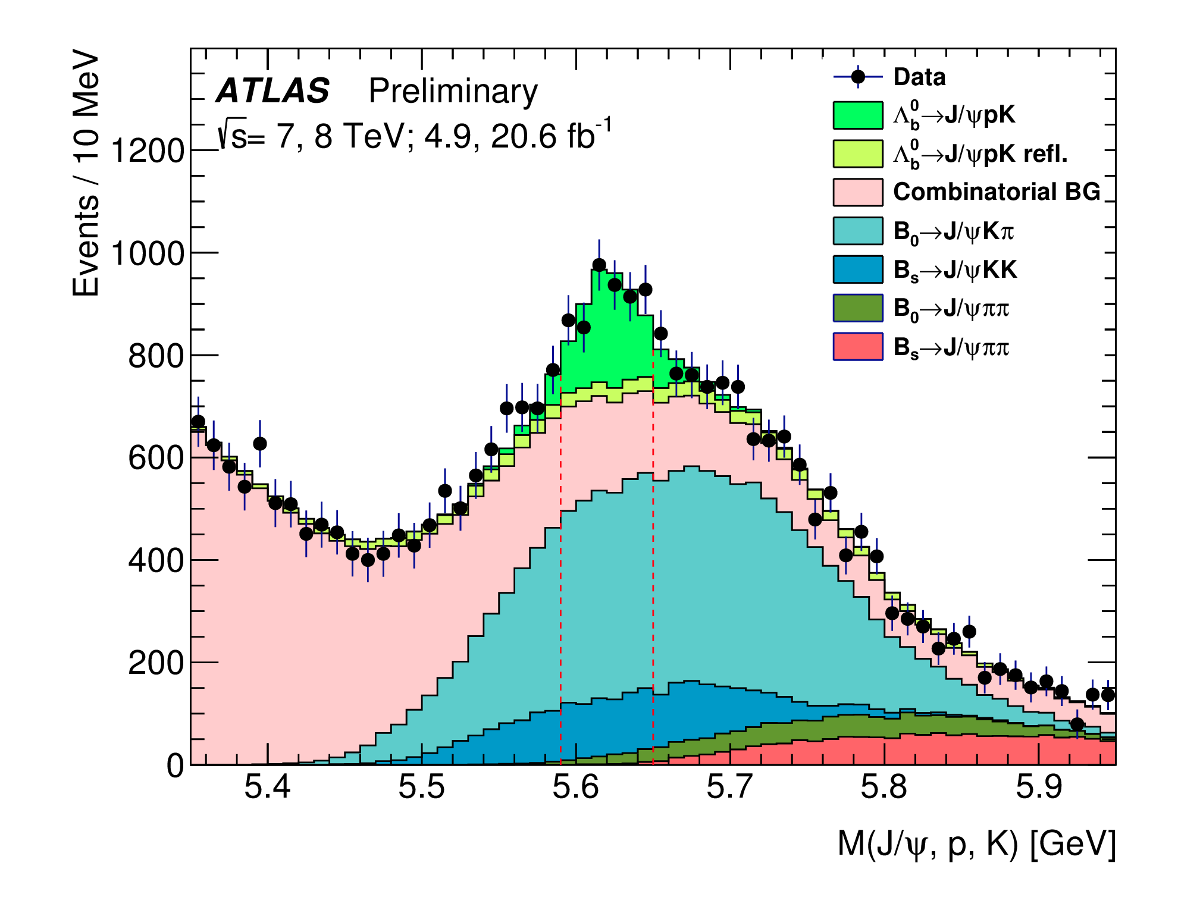
The method, continued –
Model the signal and dominant backgrounds with PYTHIA. Iteratively fit the data to the model to obtain:

Slide 20
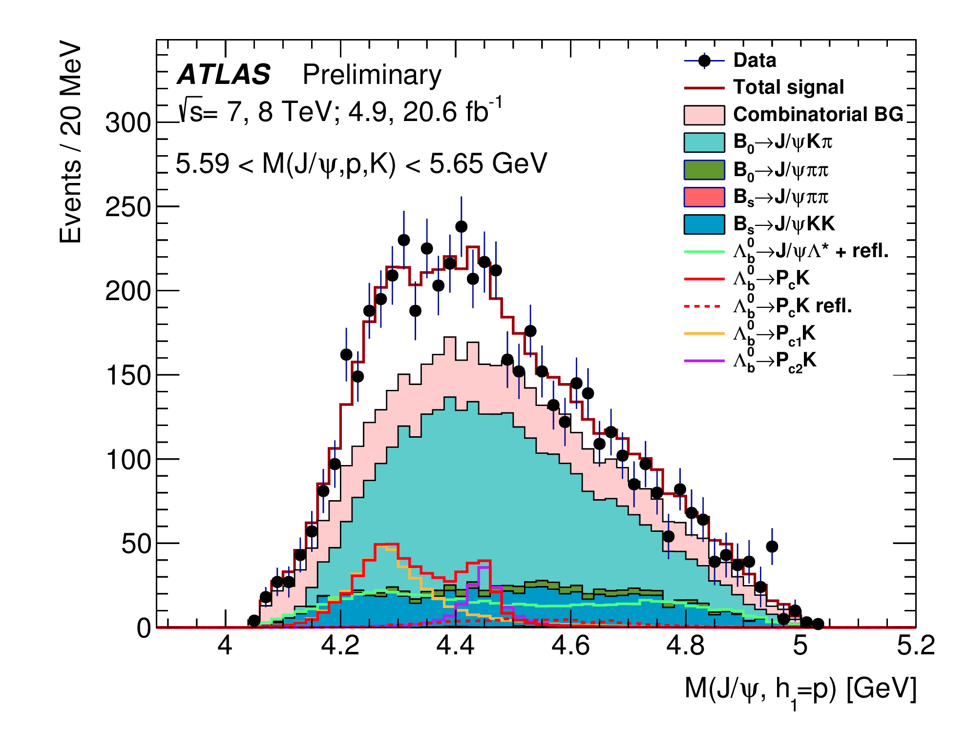
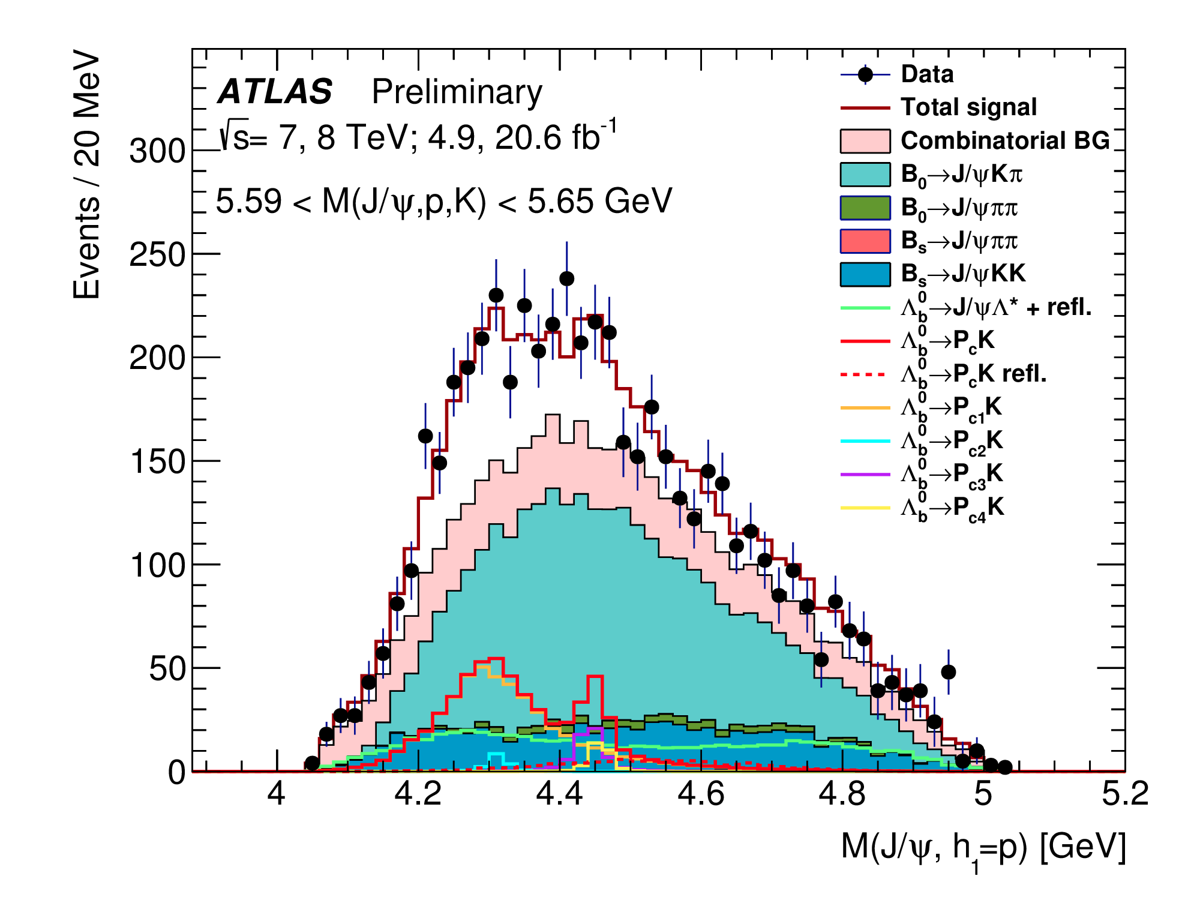
Extract the m(J/ψ p) distribution from the signal region. Fit it to pentaquark models with two (left) and four (right) pentaquarks:
With two pentaquarks –
χ²/N_{dof} = 37.1/39, and the reconstructed masses and widths are consistent with the LHCb values. When the pentaquark masses and widths are fixed to the LHCb values, χ²/N_{dof} = 37.1/39 (p-value = 24.5%)
With four pentaquarks –
χ²/N_{dof} = 37.1/42

Slide 21
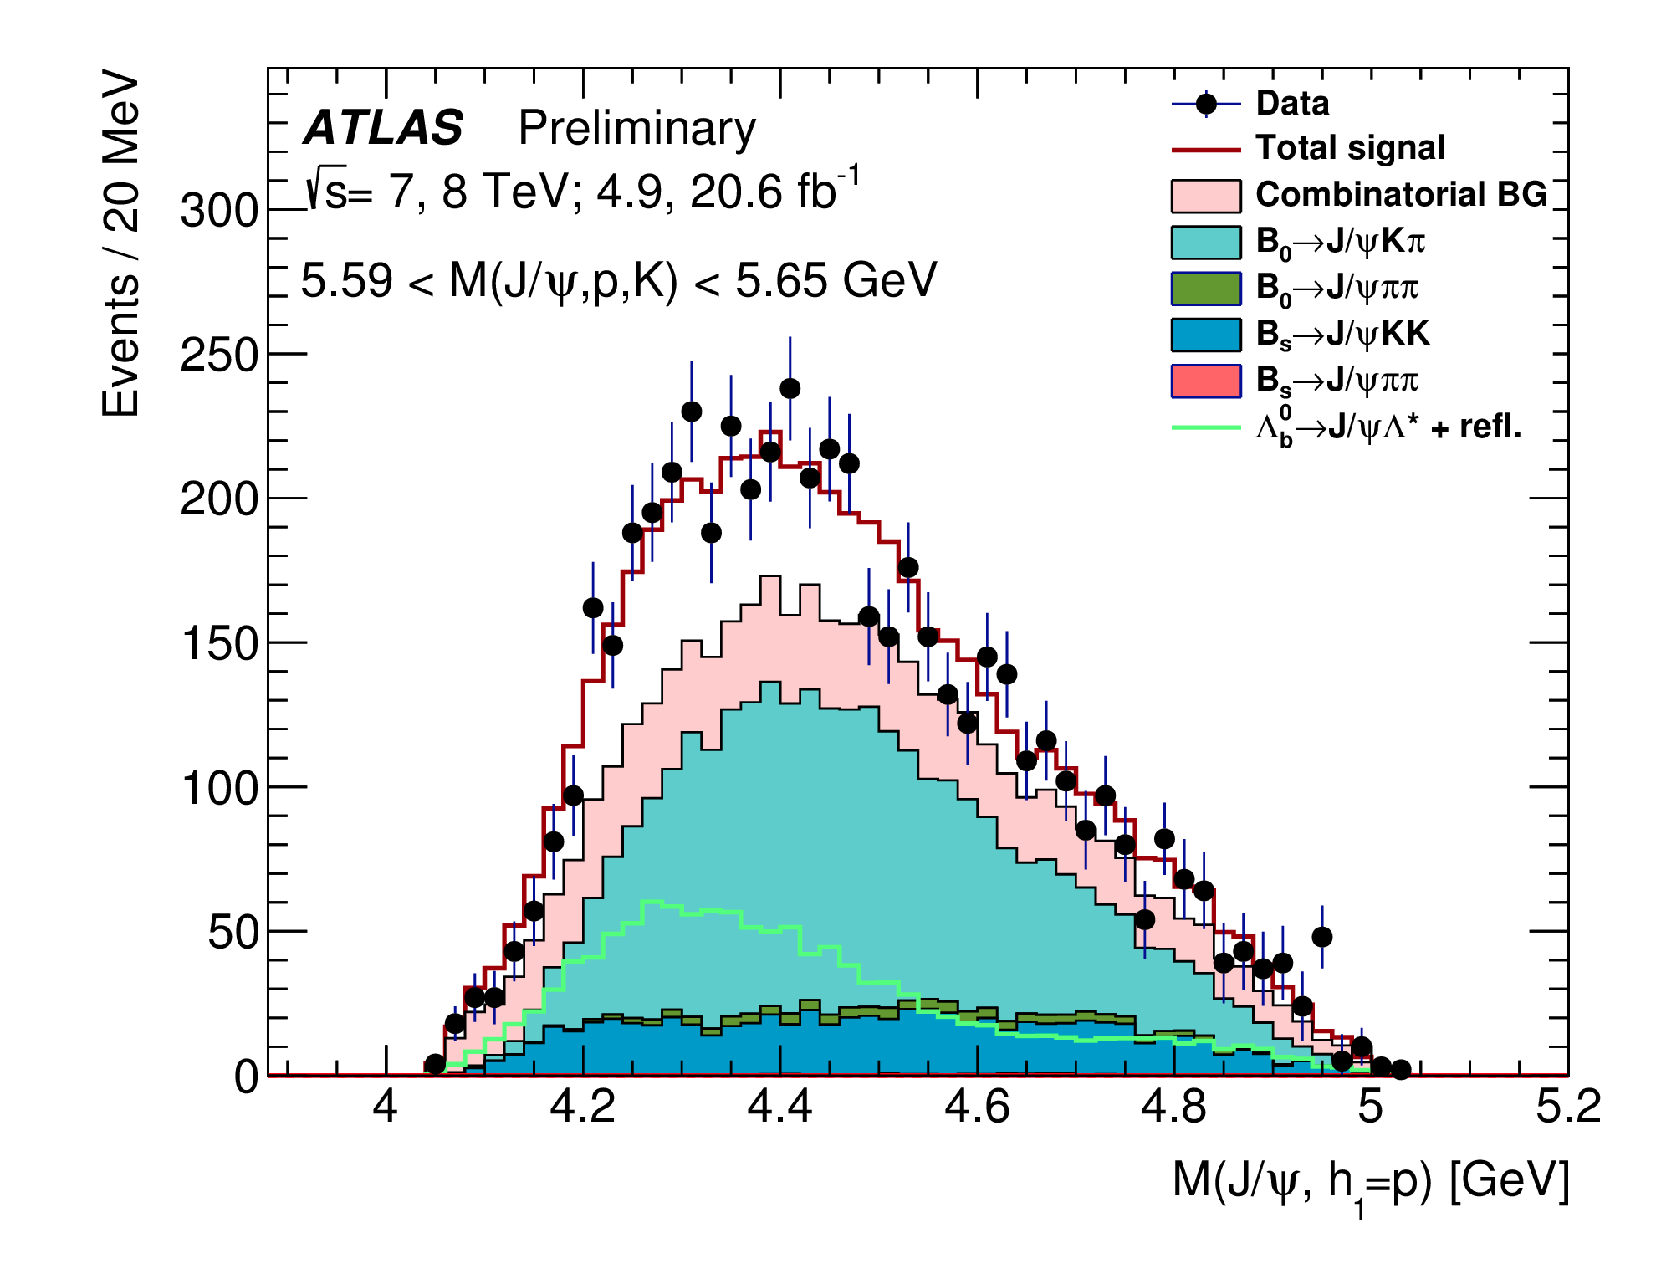
Testing the hypothesis without pentaquarks, using an extended decay model (involving particular assumptions about non-resonant Λ_{b}⁰ decays through intermediate Λ*(1800), Λ*(1800), Λ*(1800) states), produces:
Model with zero pentaquarks – χ²/N_{dof} = 42.0/23 (p-value 9.1 × 10⁻³).

Slide 22
Summary
ATLAS presents 4 recent results on quarkonium and heavy flavors:
Measurement of J/ψ production in association with a W± boson – to assess the agreement of data with a Color Octet model; while there is reasonable agreement at low p_{T}, some inclusion of Color Singlet may be needed to improve the agreement at high p_{T}.
Measurement of the production cross section of B_{c} mesons relative to B± mesons – new data in an energy and fiducial volume regime for which no prediction exists, and some indication of p_{T} dependence in the ratio.
Measurement of the production cross section of J/ψ and ψ(2S) mesons at high p_{T} – non-prompt production fraction diverges from prediction increasingly with growing p_{T}.
Study of J/ψ p resonances in decays – probable confirmation of the LHCb pentaquark result.

