Slide 4
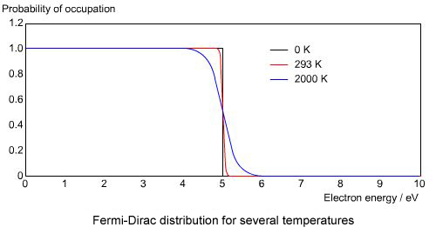
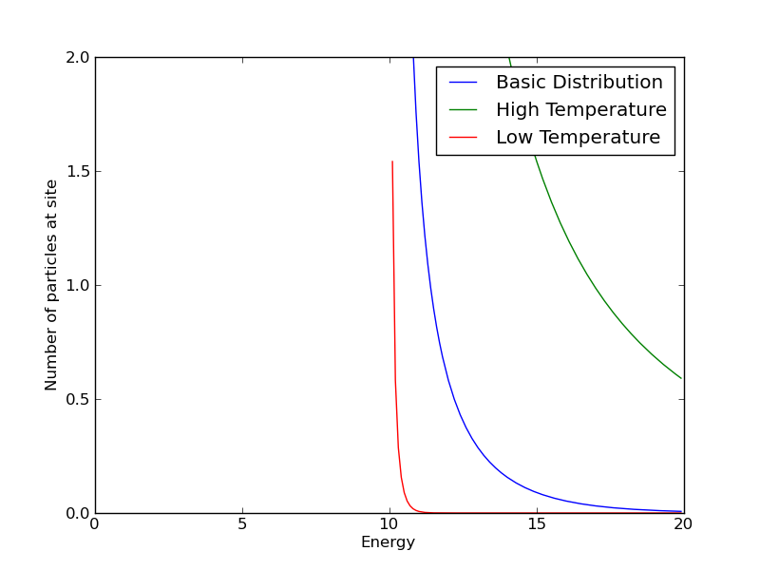
μ
higher temperatures
lower temperatures
μ

Slide 9
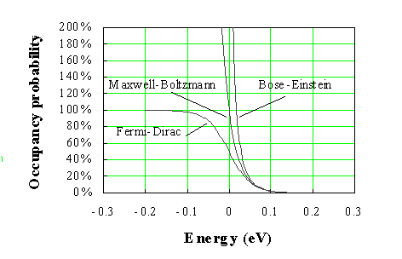

Slide 13
a
b
ab
b
a
ab

Slide 19
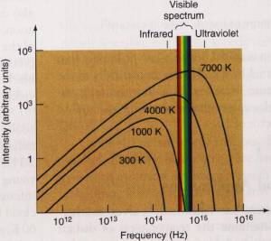

Slide 26
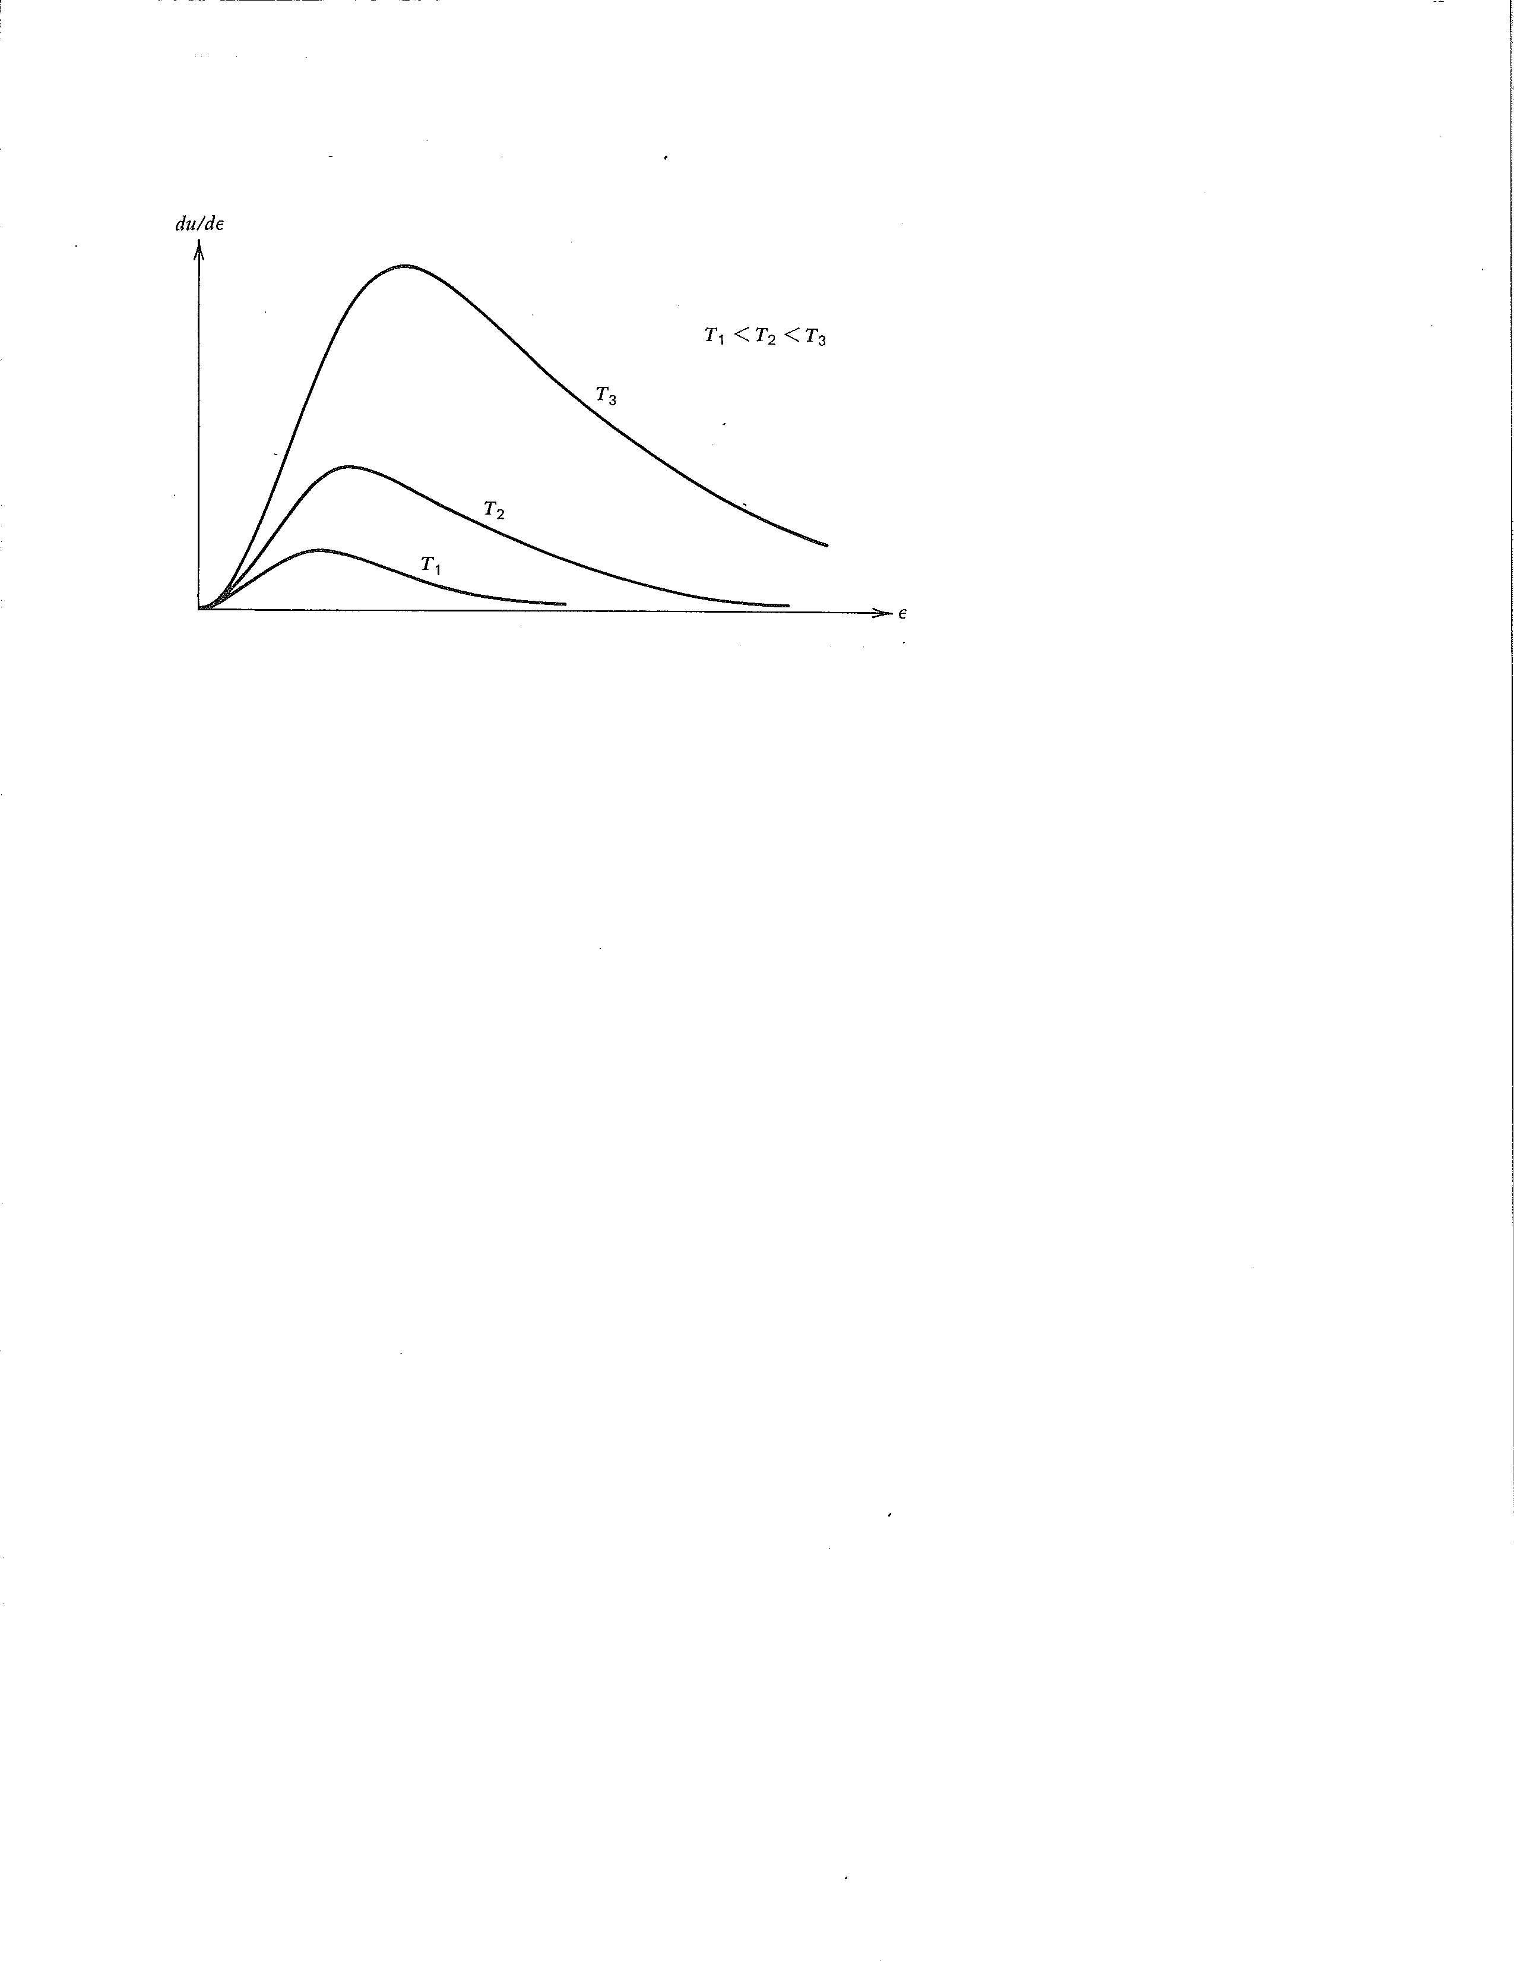

Slide 28
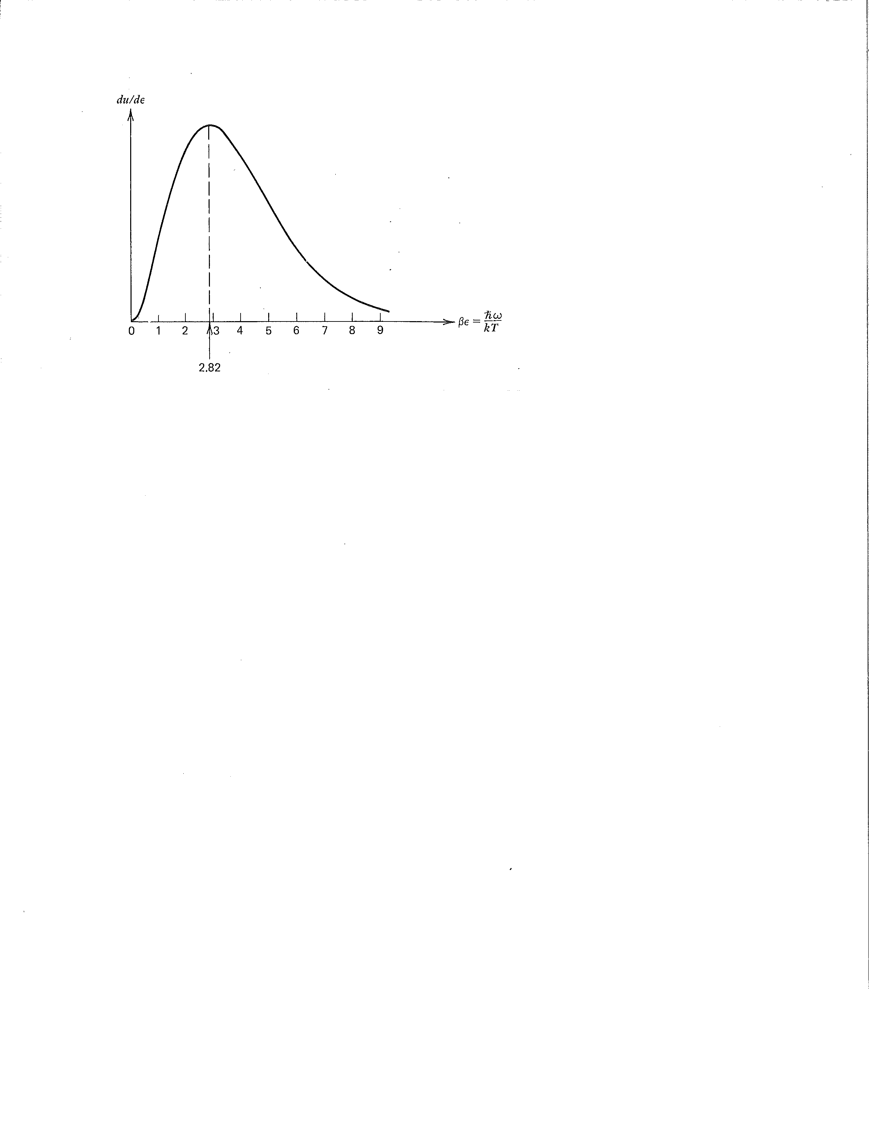

Slide 34
unit area above
the radiator

Slide 35
z-axis
θ
photon direction

Slide 38
white light, green body
white light, black body
green light, green body
green light, red body
green light, black body

