Slide 10
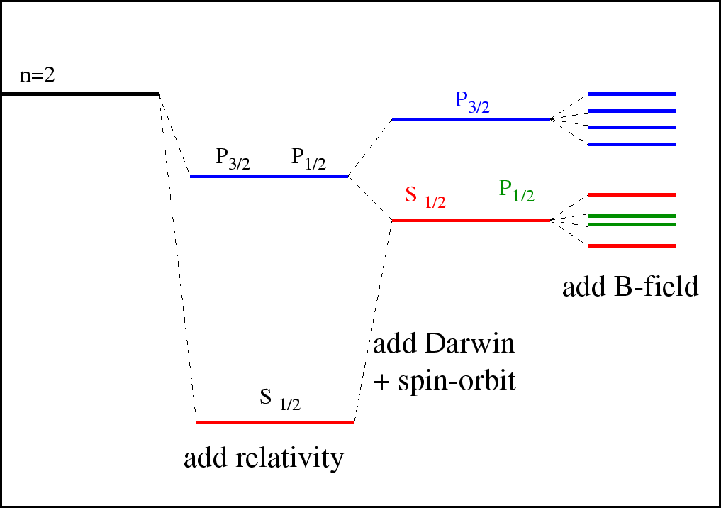

Slide 16
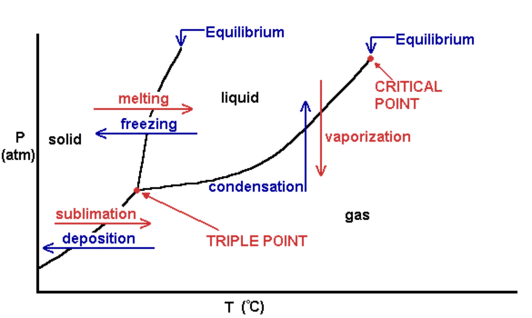

Slide 18
Some property, for example volume
some property, for example pressure
At these points, the second derivative is undefined, because the slope is discontinuous. This is a second order phase transition.
Here the first derivative is undefined. This is a first order phase transition.

Slide 25
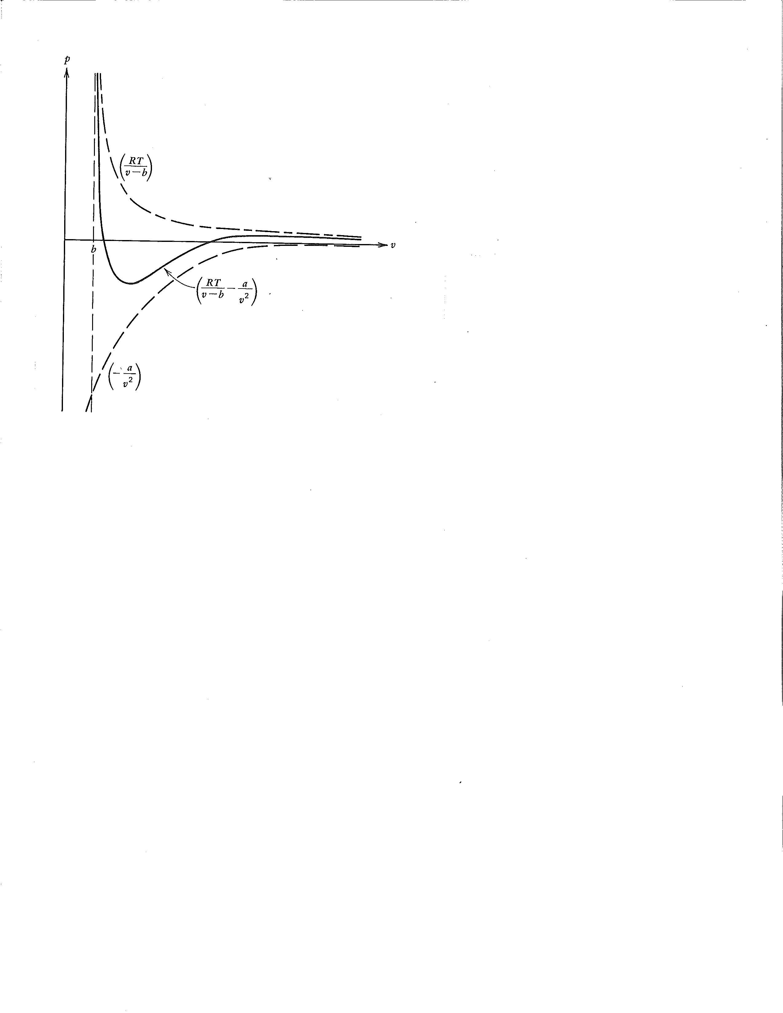

Slide 26
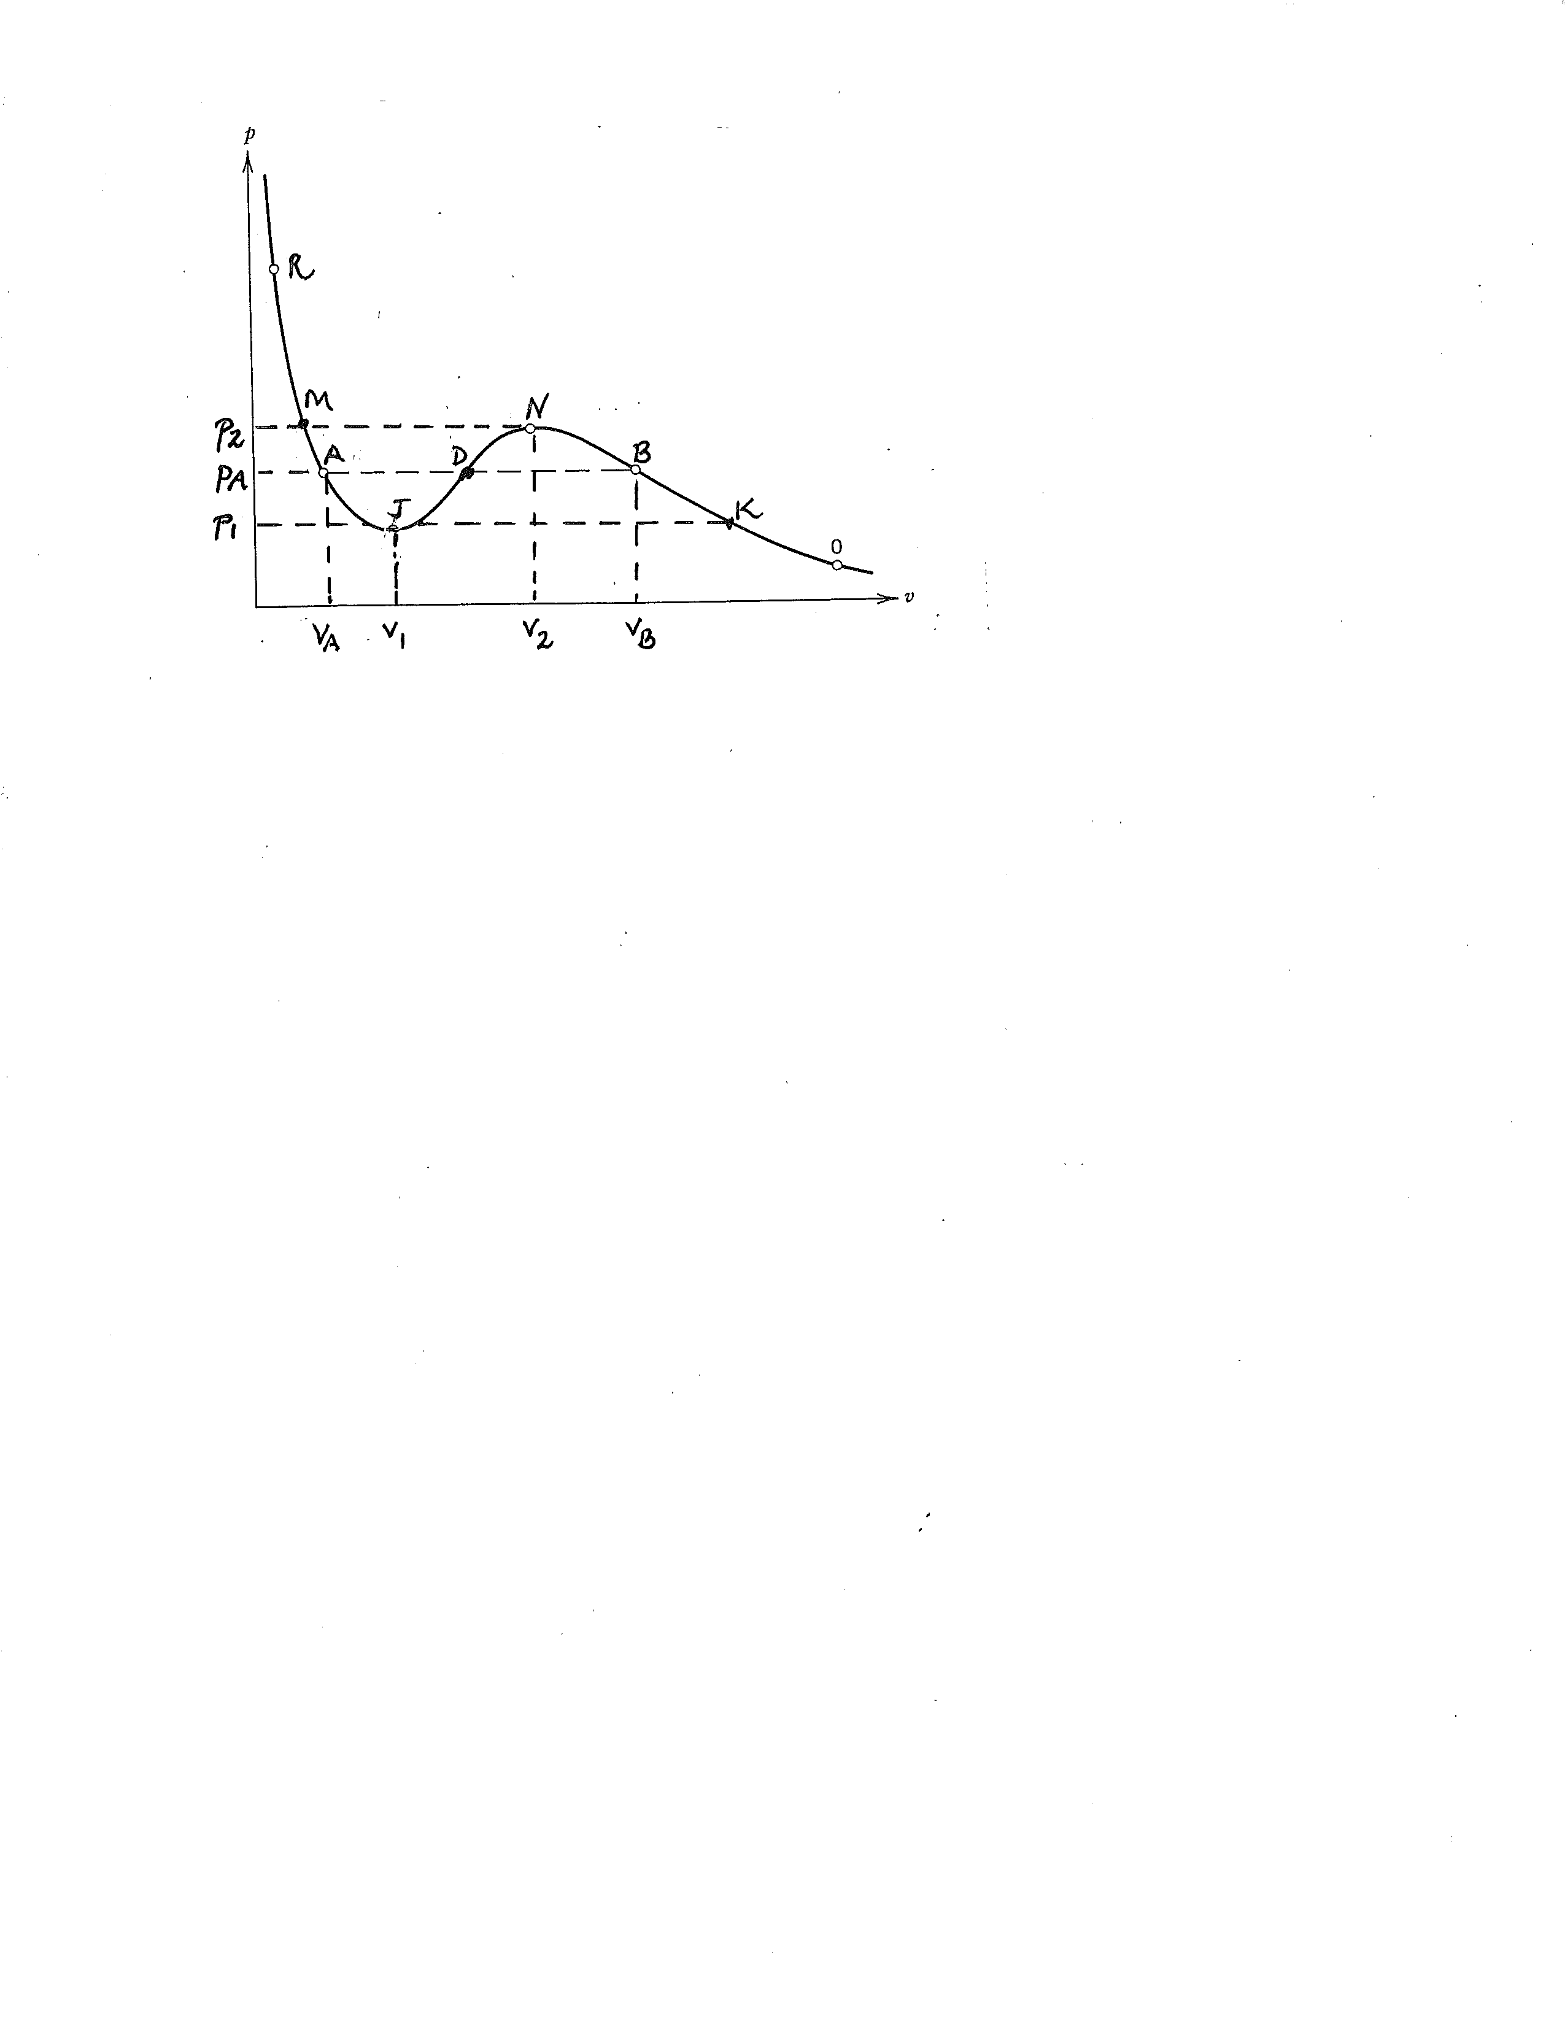

Slide 29
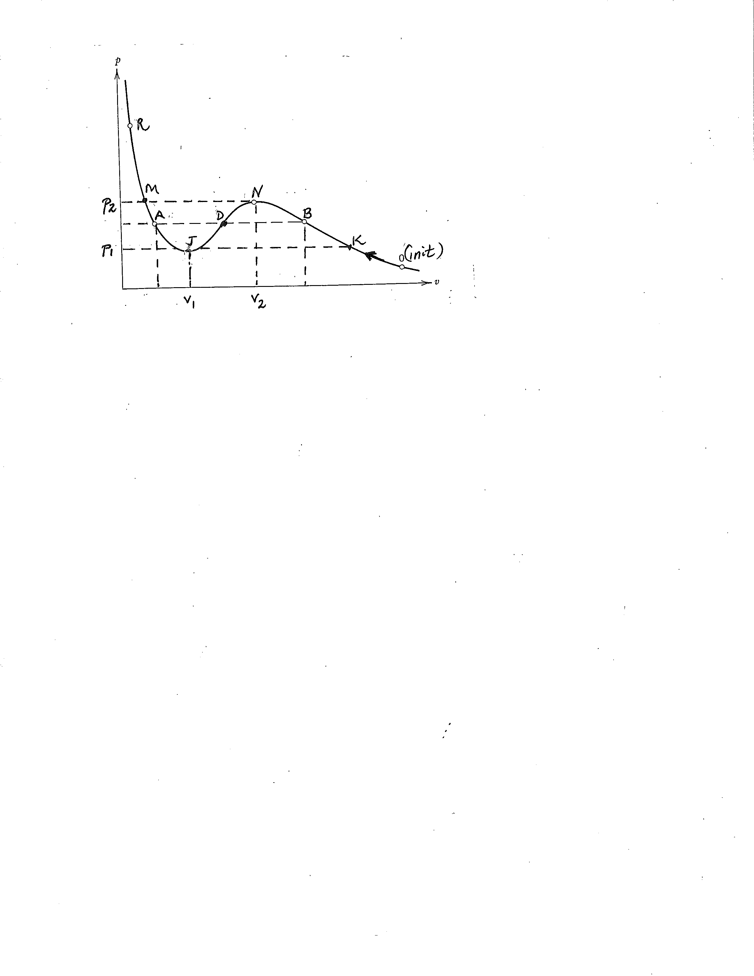
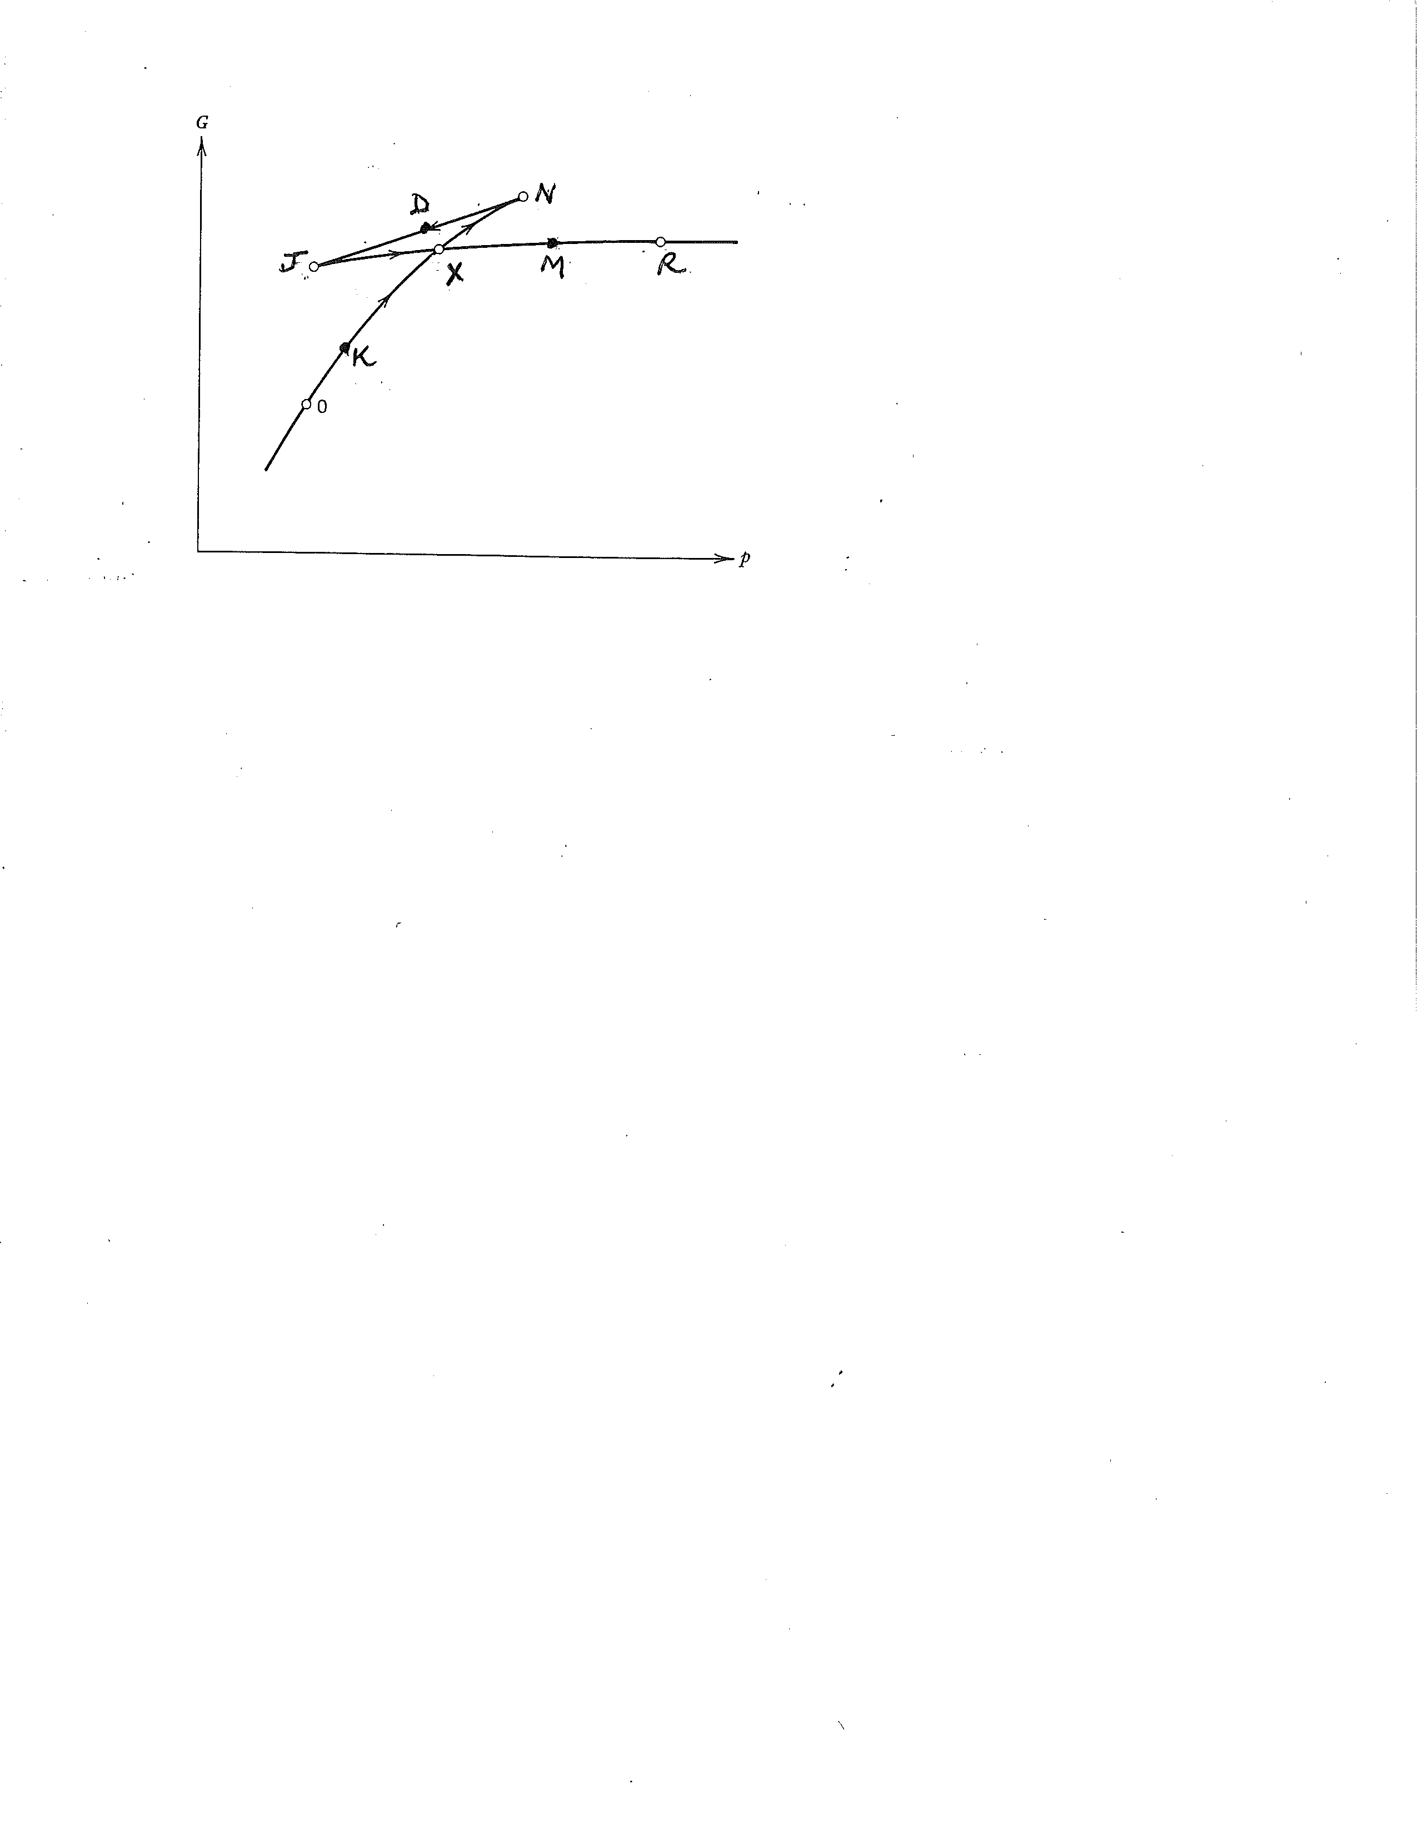

Slide 30
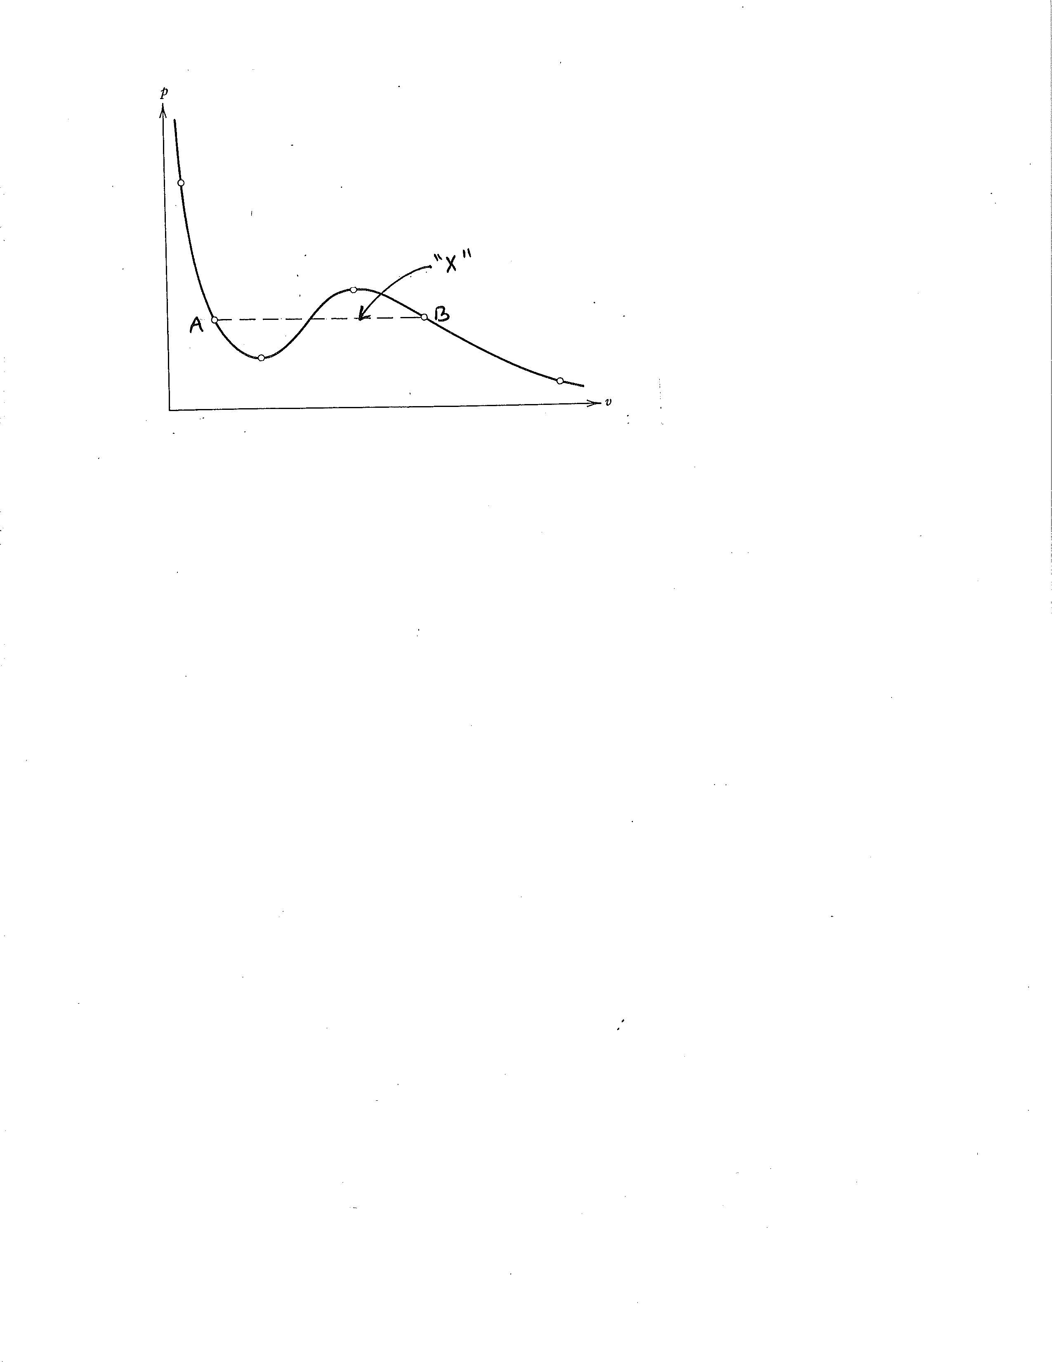

Slide 32
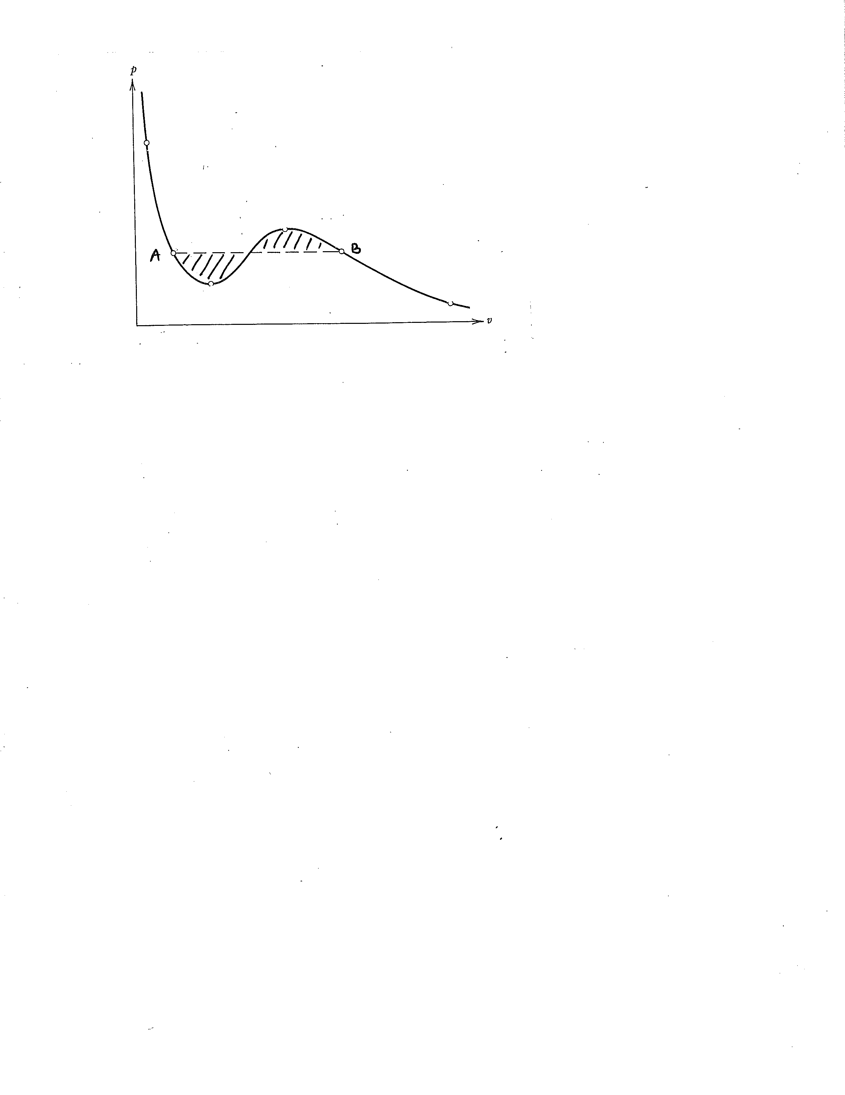

Slide 34
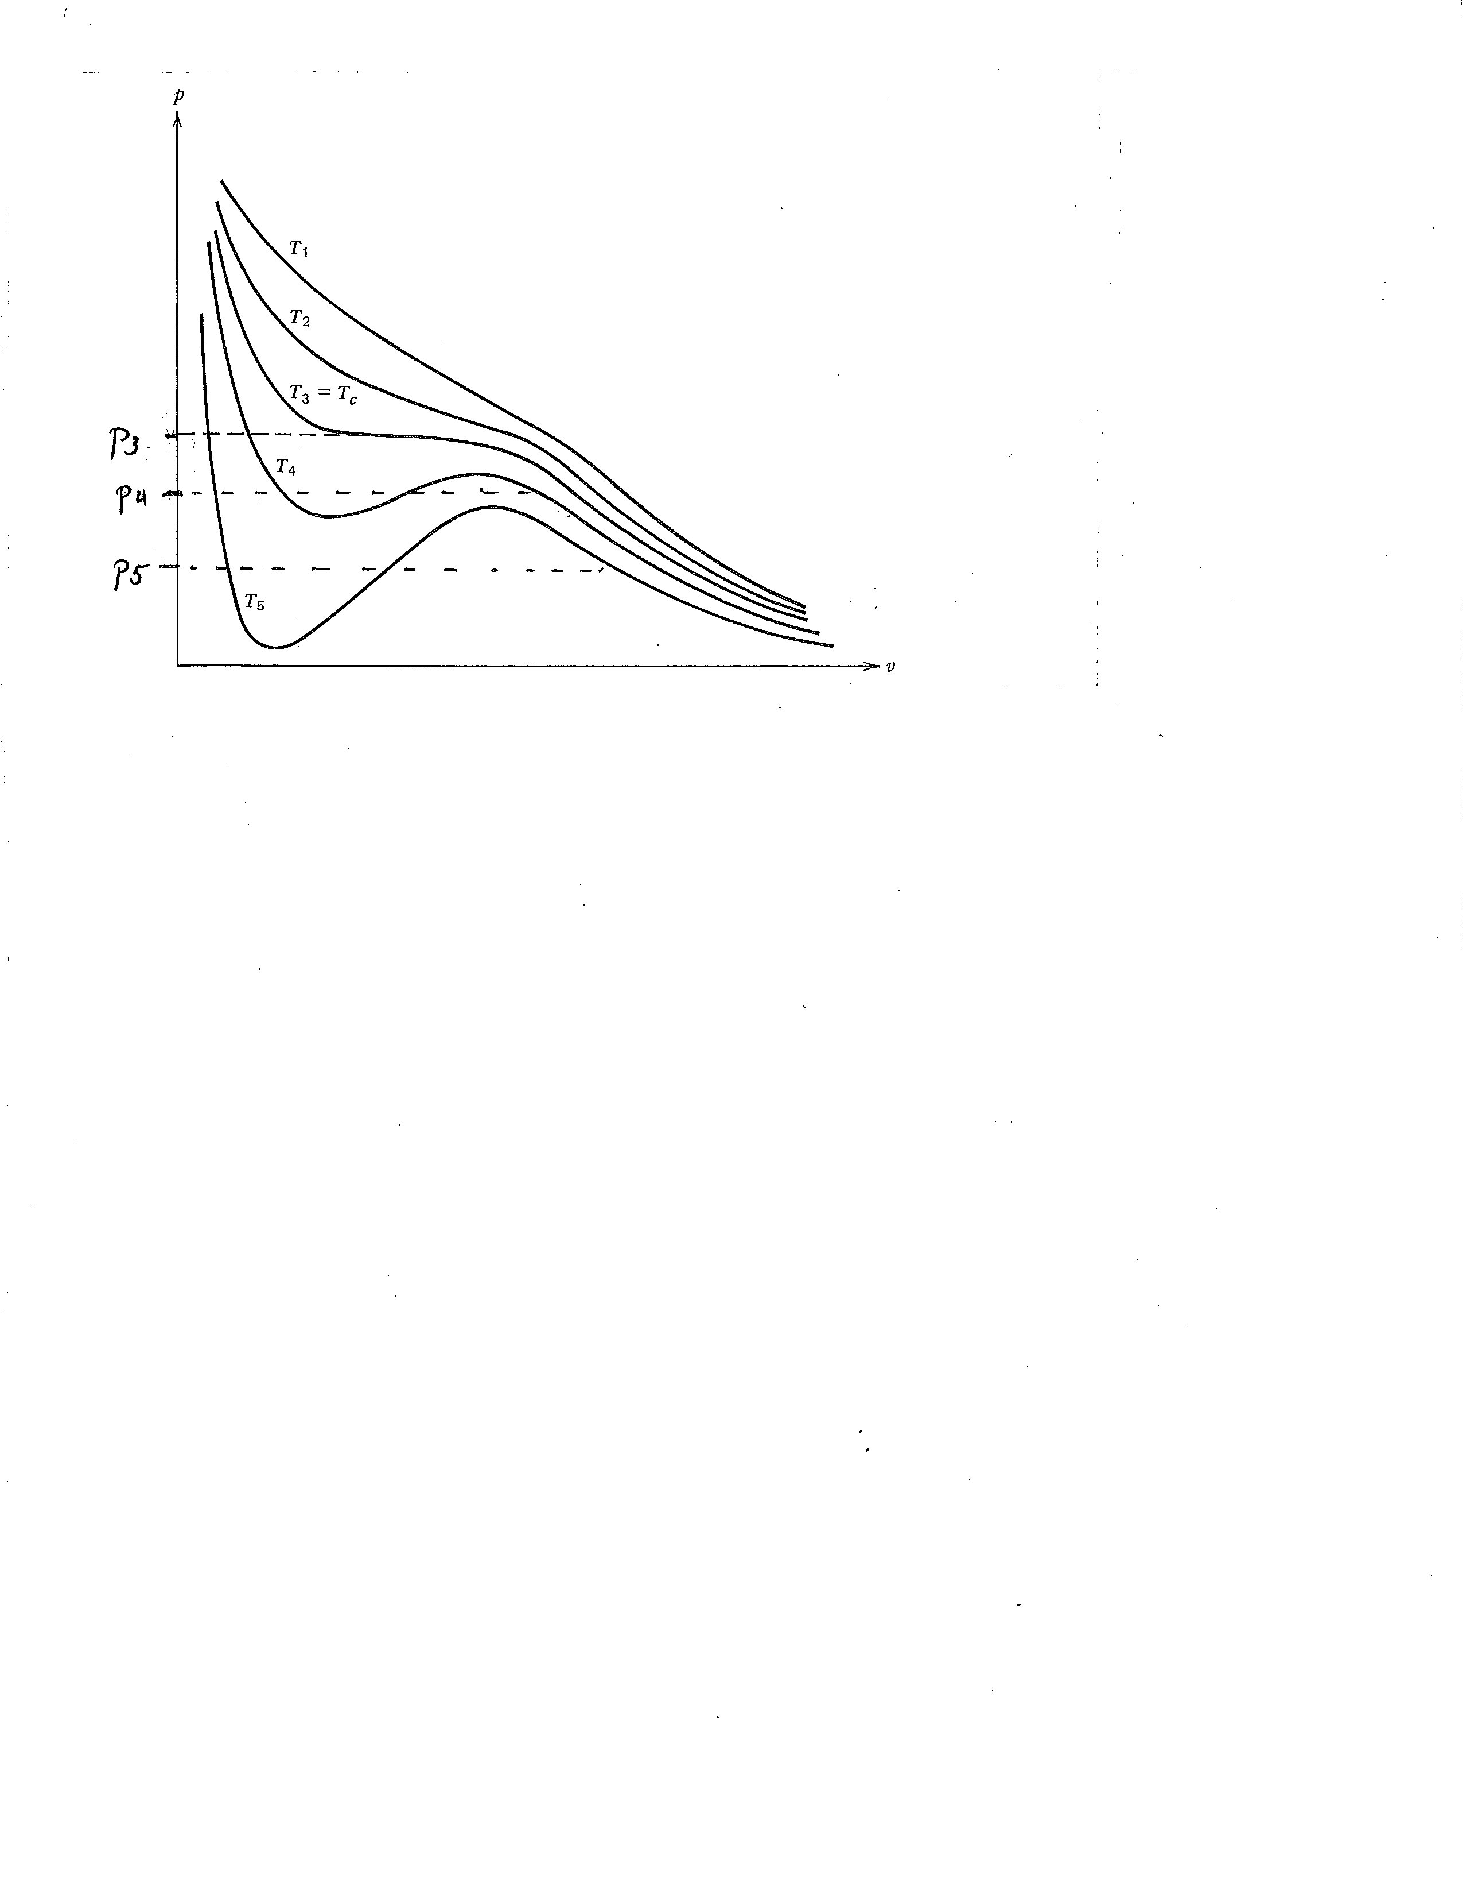

Slide 35
path 2
Z
The critical point
path 1
Y

Slide 36
p
T

Slide 37
p
dT
T

