Slide 2
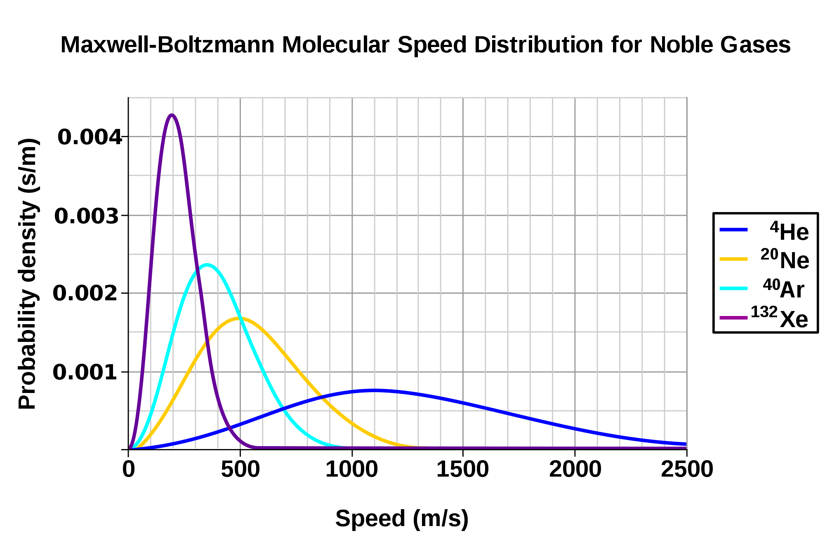

Slide 3
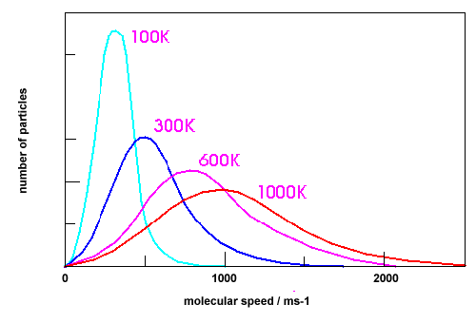

Slide 6
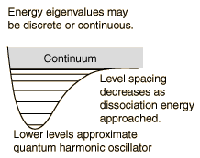
range

Slide 10
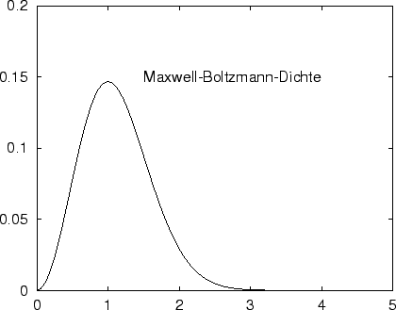
v/”v_{max}”= v/v_{most probable}

Slide 15
dV

Slide 22
R
R

Slide 23
2R

Slide 35
y
θ
x

