Slide 51
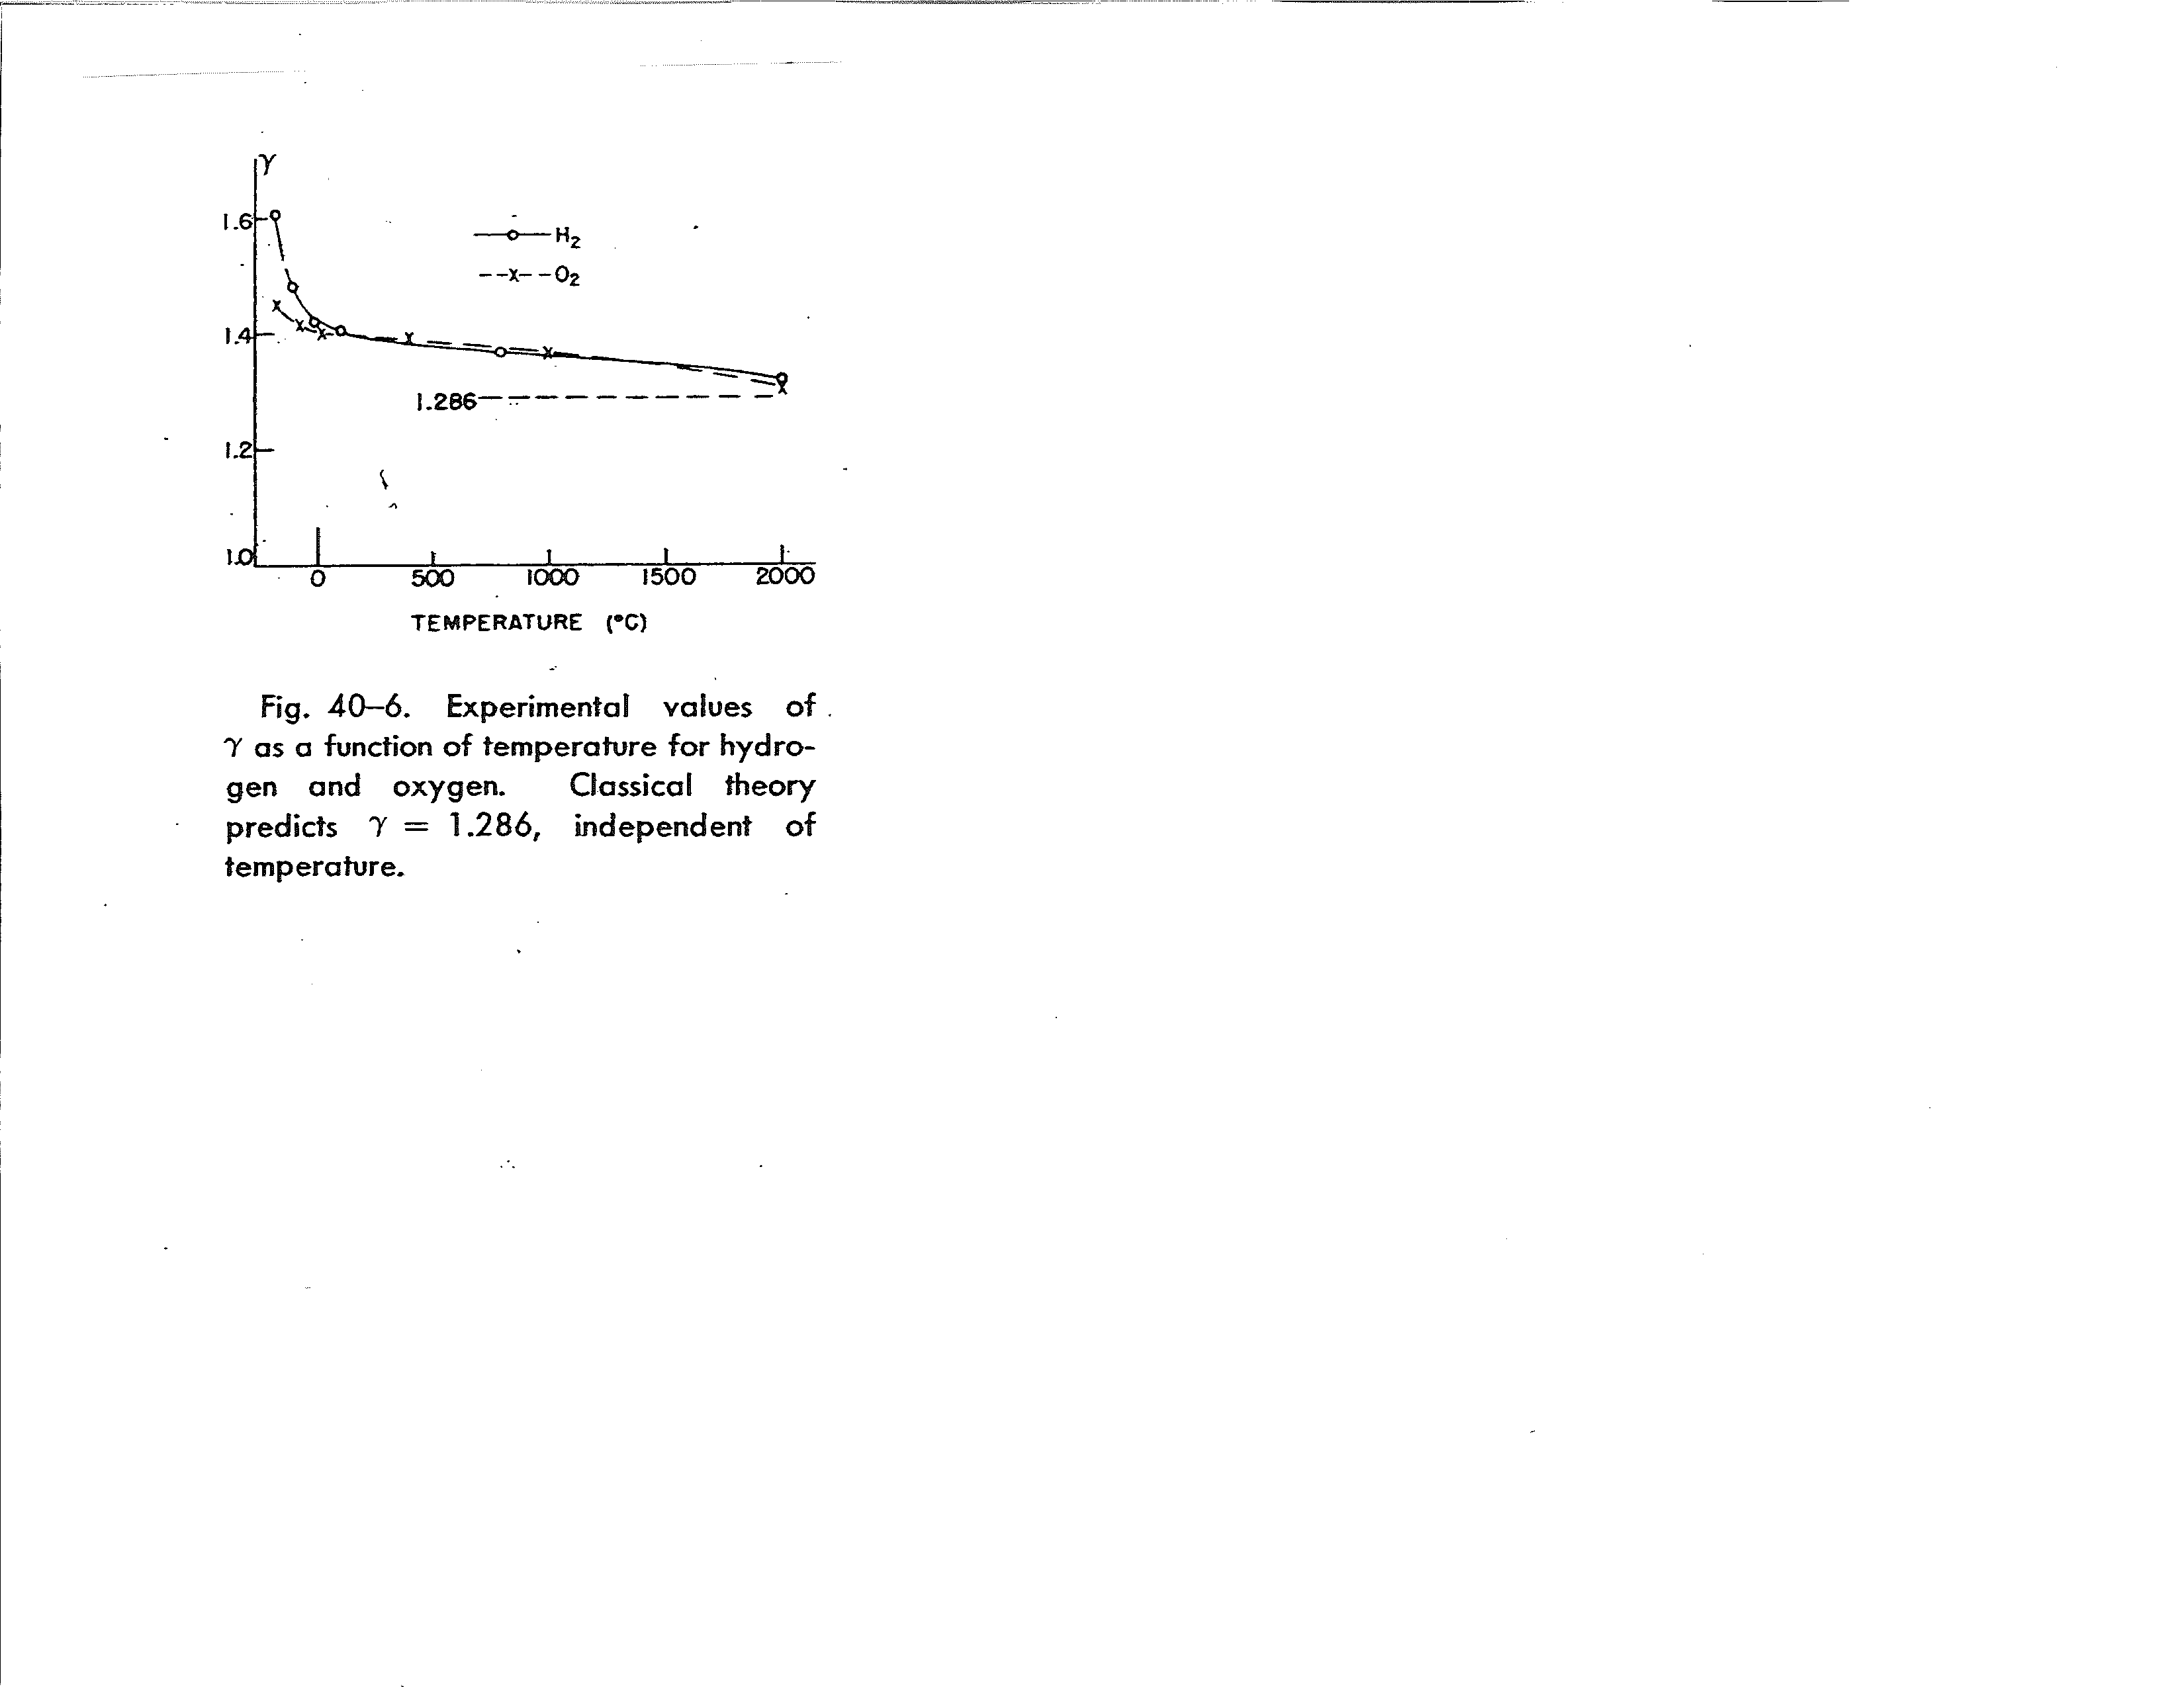
The theoretically predicted value for diatomic molecules, γ=1.286, does not onset until T=2273 K.

Slide 52
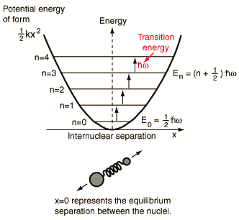

Slide 54
γ or c_{V}
add vibrational dof’s
add rotational dof’s
translational dof’s only
100 1000 10000
Temperature (K)
(Log scale)
$υ$nRT

Slide 56
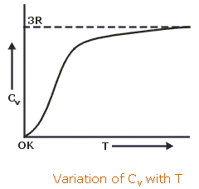
300K

