Slide 11
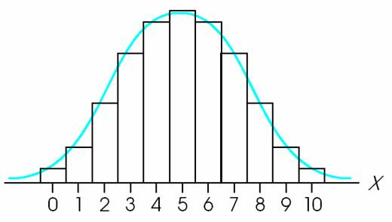

Slide 32
S (or Ω)
E₀ (could be zero)
E

Slide 37
E
S=klnΩ
E
V
E
N

Slide 48
A₂
A₁

