Slide 20
z
dS
y
x
dA

Slide 30
 | Subsystem 1 | Subsystem 2
#dof (N) | 6 | 10
Energy | E₁ | E₂=5-E₁
#accessible states Ω₀ | (E₁)^{6/2}=(E₁)³ | (E₂)^{10/2}=(E₂)⁵
E₁ | E₂ | Ω₁=(E₁)³ | Ω₂=(E₂)⁵ | Ω₀=Ω₁Ω₂ | Ω₀/Ω_{tot}
0 | 5 | 0 | 3125 | 0 | 0
1 | 4 | 1 | 1024 | 1024 | 0.26
2 | 3 | 8 | 243 | 1944 | 0.50
3 | 2 | 27 | 32 | 864 | 0.22
4 | 1 | 64 | 1 | 64 | 0.02
5 | 0 | 125 | 0 | 0 | 0

Slide 31
 | Subsystem 1 | Subsystem 2
#dof (N) | 4×10²⁴ | 8×10²⁴
E₁ | E₂ | Ω₁=(E₁)^{N(1)/2} | Ω₂=(E₂)^{N(2)/2} | Ω₀=Ω₁Ω₂
0 | 5 | 0 | 10^{2.8×10^24} | 0
1 | 4 | 1 | 10^{2.4×10^24} | 10^{2.4×10^24}
2 | 3 | 10^{0.6×10^24} | 10^{1.9×10^24} | 10^{2.5×10^24}
3 | 2 | 10^{1.0×10^24} | 10^{1.2×10^24} | 10^{2.2×10^24}
4 | 1 | 10^{1.2×10^24} | 1 | 10^{1.2×10^24}
5 | 0 | 10^{1.4×10^24} | 0 | 0

Slide 35
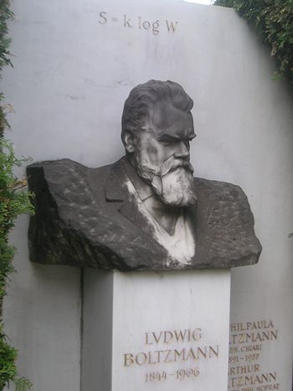

Slide 40
A₂
Q
A₁

Slide 47
A₂
Q
A₁

Slide 56
S (or Ω)
E

