Slide 39
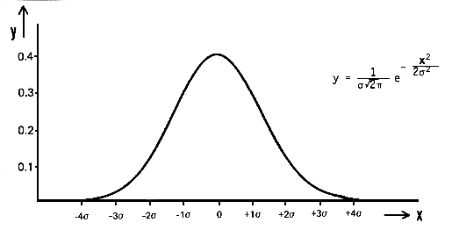

Slide 46
Particle 1, individual states | 1 | 1 | 1 | 2 | 2 | 2 | 3 | 3 | 3
Particle 2, individual states | 1 | 2 | 3 | 1 | 2 | 3 | 1 | 2 | 3
Combined two-particle system | 1 | 2 | 3 | 4 | 5 | 6 | 7 | 8 | 9

